Slide 1
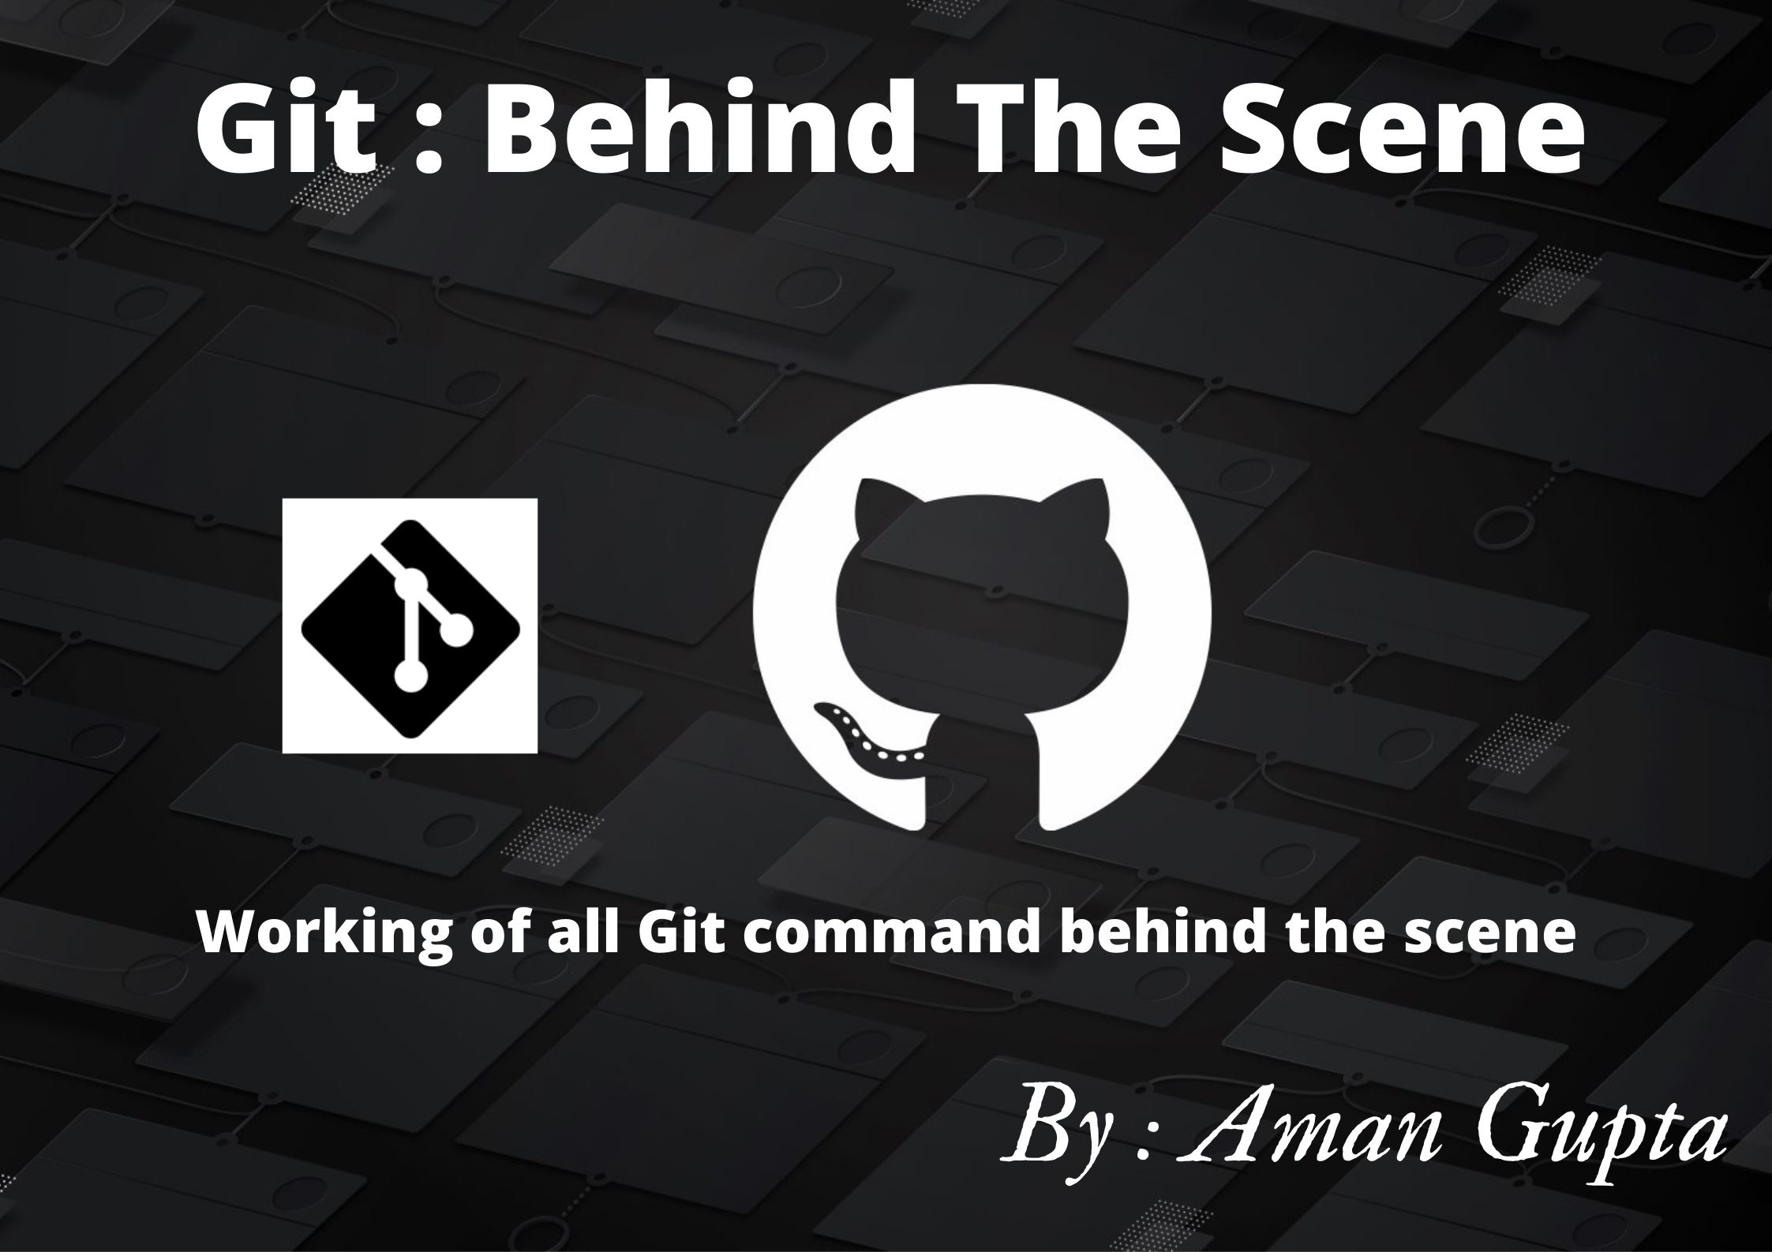

Slide 2
Index
We will be dealing with the following topics
Introduction to Git and Github (Theory)
Working of Git command Behind the scene
a. Making our Project Version Control
b. Git Branching
c. Git Undoing
d. Git Merging
SSH Authentication
Pushing code to the Github

Slide 3
Introduction to Git and Github

Slide 4
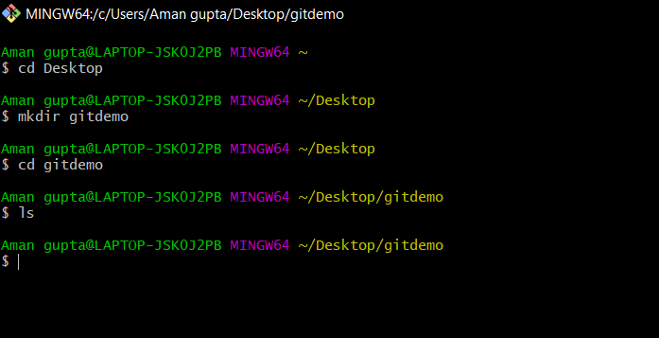

Working of Git Command Behind the scene
Making our Project Version Control
Step 1: Create a Project Directory
(Linux command for creating a Project directory )
gitdemo
(Project Directory)

Slide 5
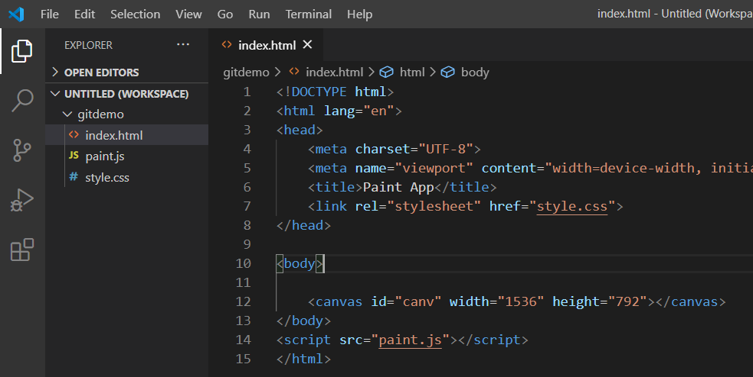


Step 2: Add files to Project Directory
(Three files are added to project directory “gitdemo” i.e index.html , style.css , paint.js)
gitdemo
Project files

Slide 6
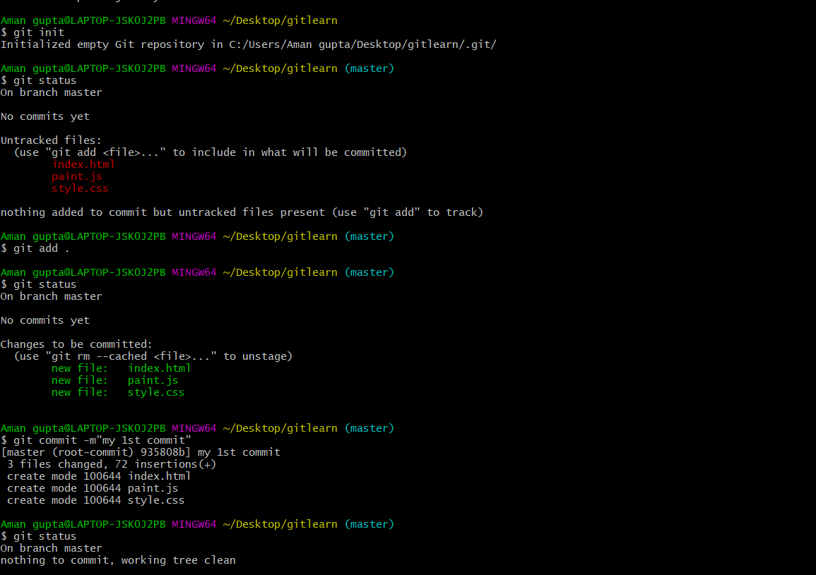
Step 3: Initializing a Repository
(Command for creating a Project directory)

Slide 7
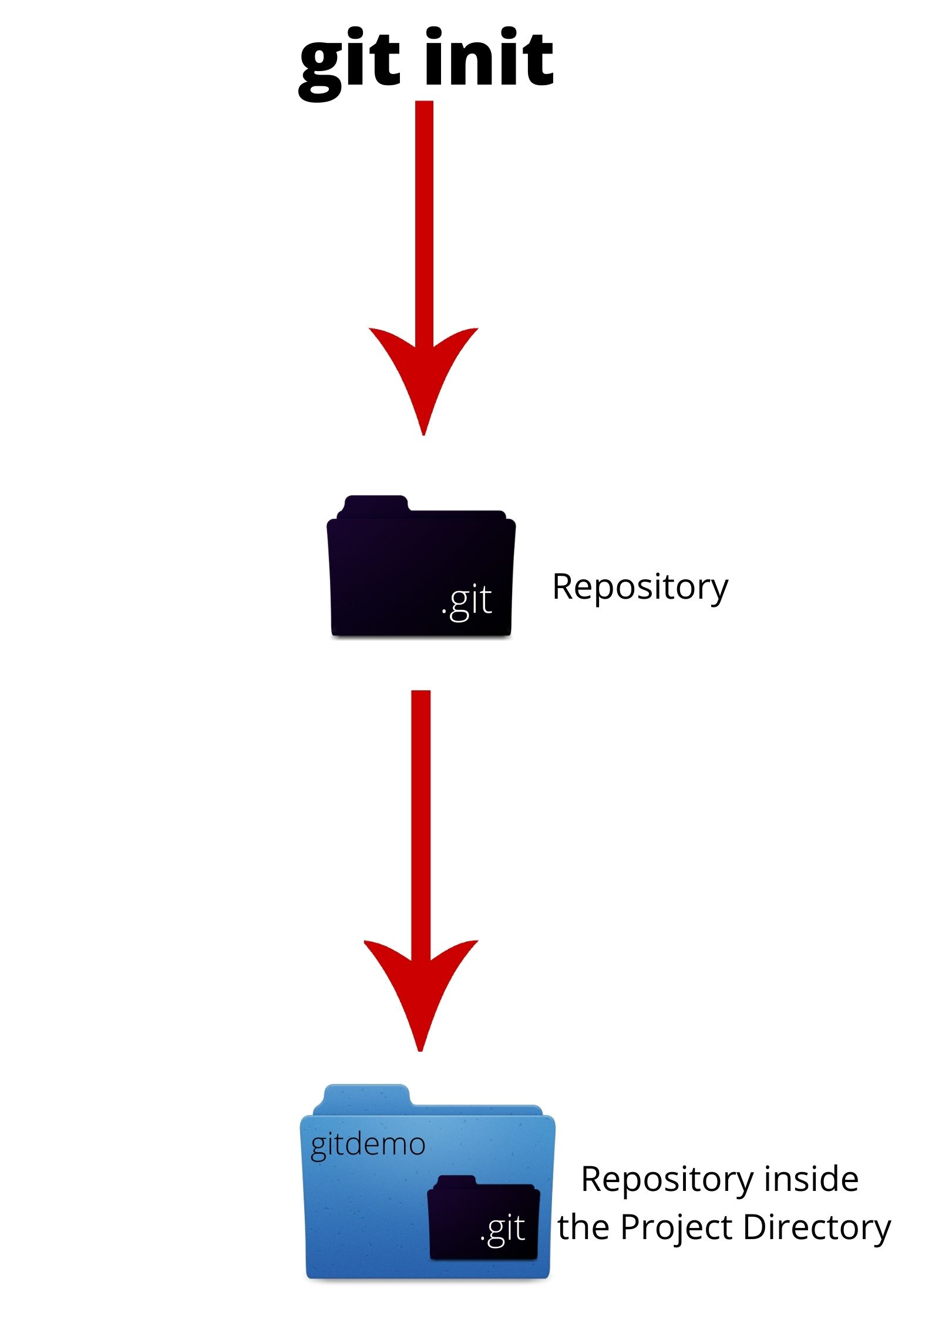
Behind the scene working of all commands
1. git init
Behind the scene

Slide 8
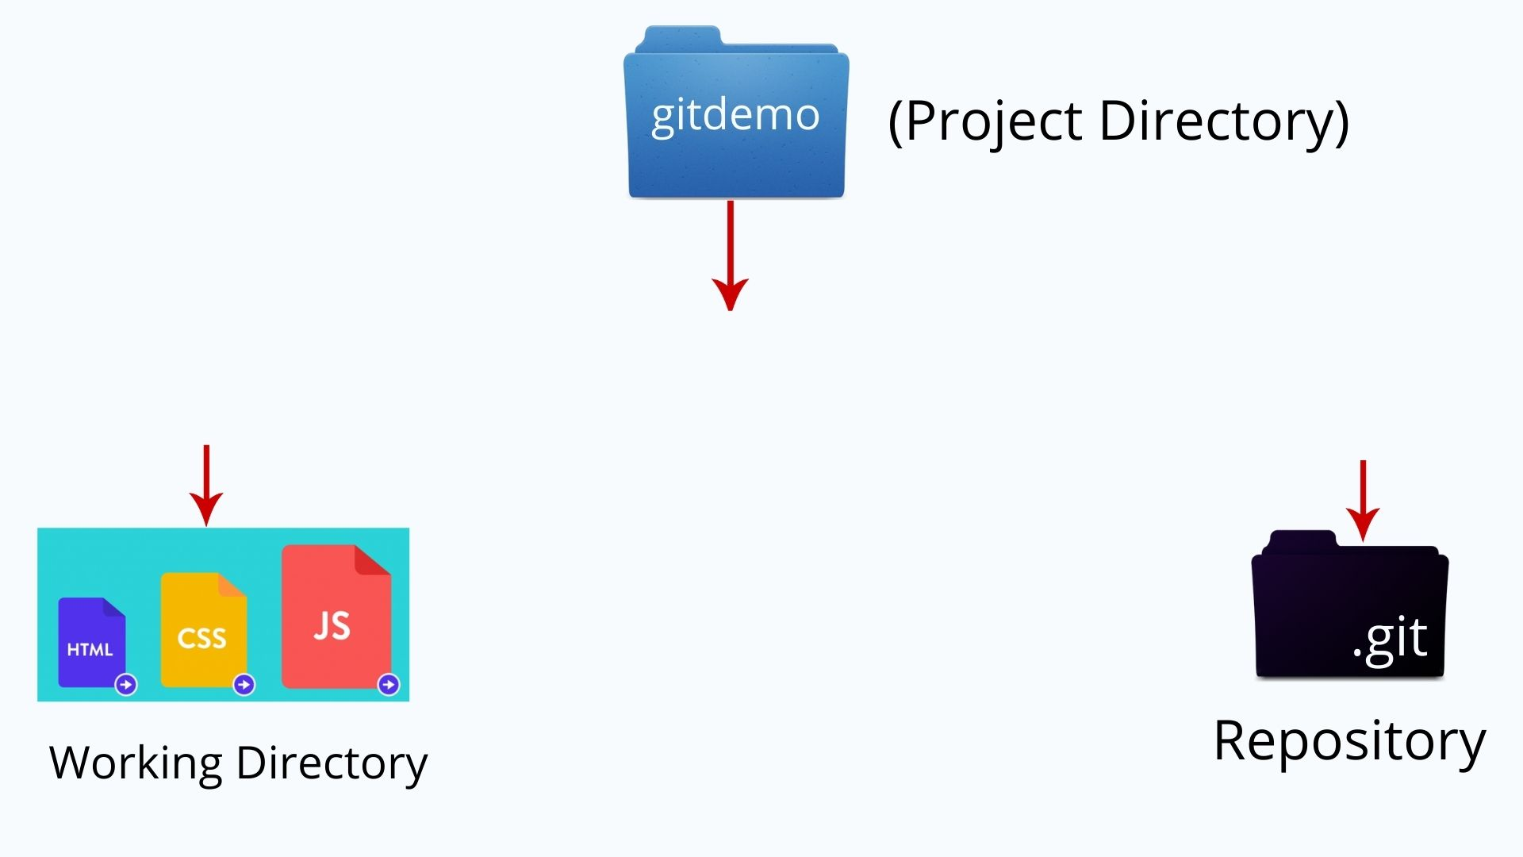
Project Directory Visualization

Slide 9
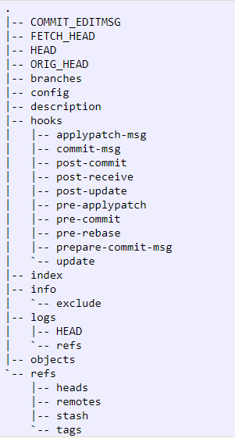

Dissecting .git folder
Basic Structure of .git folder
.git
(Repository)

Slide 10
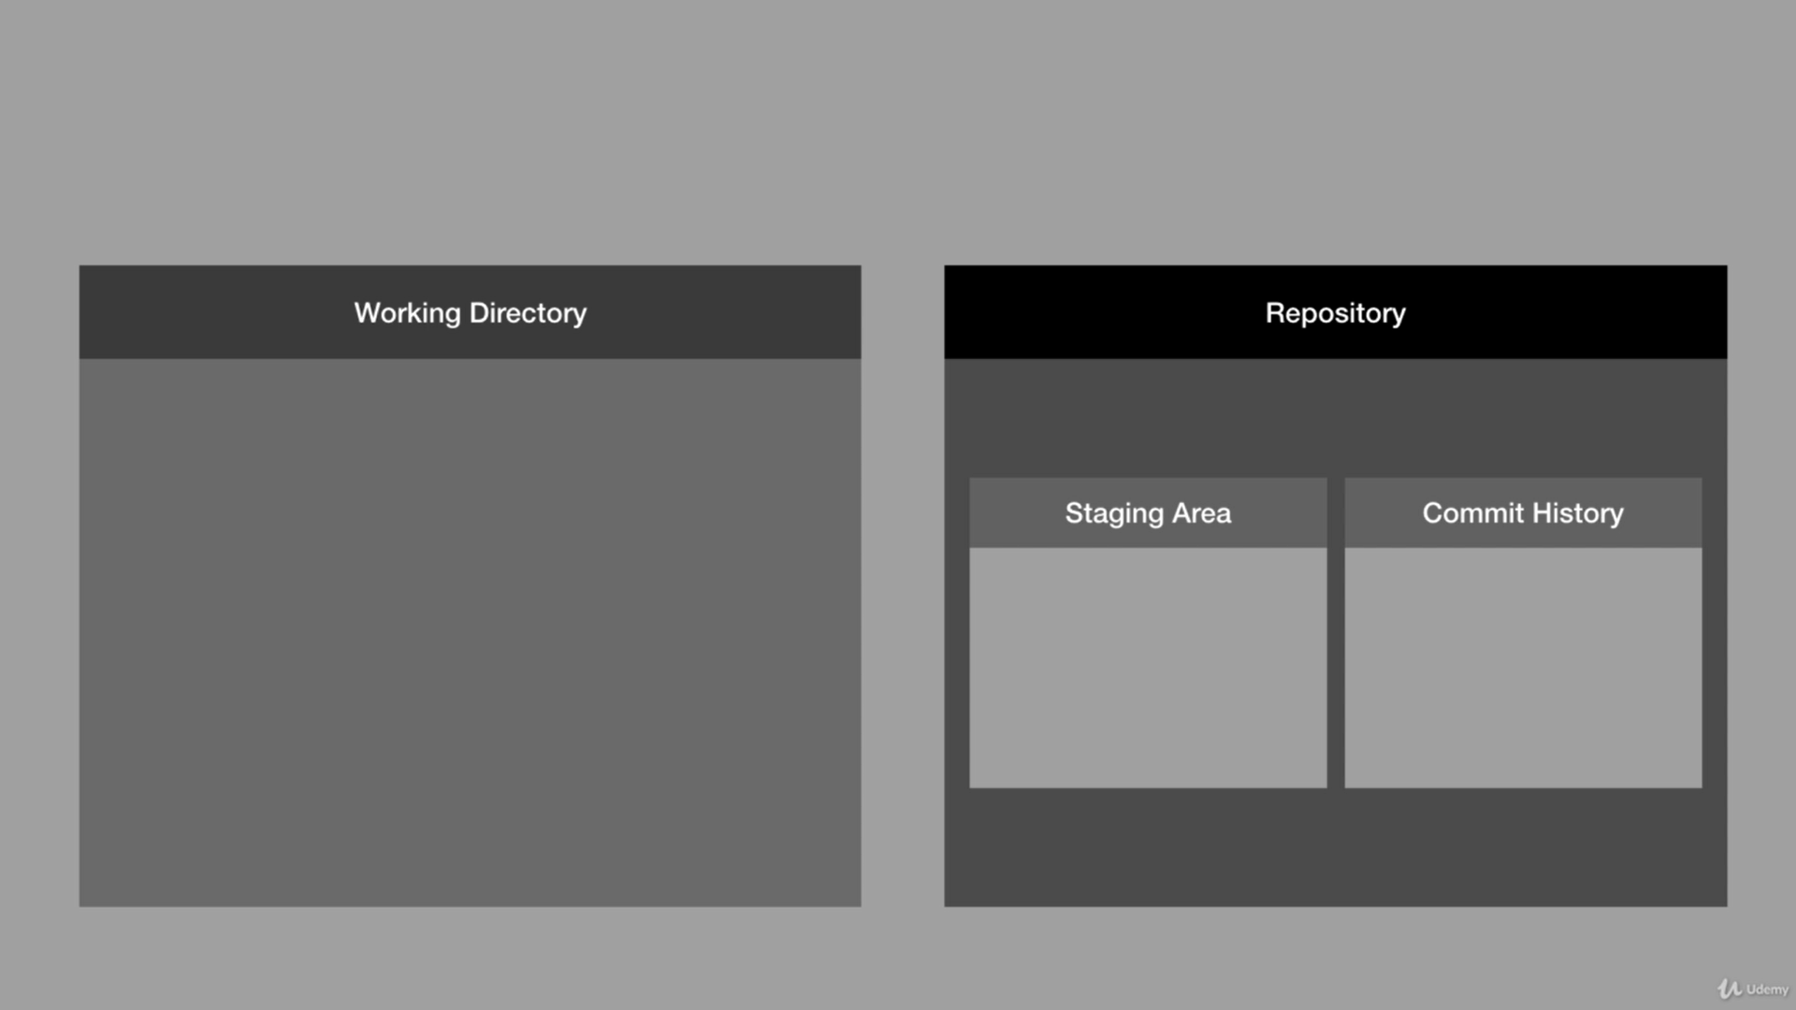
Simple Visualization of Repository

Slide 11
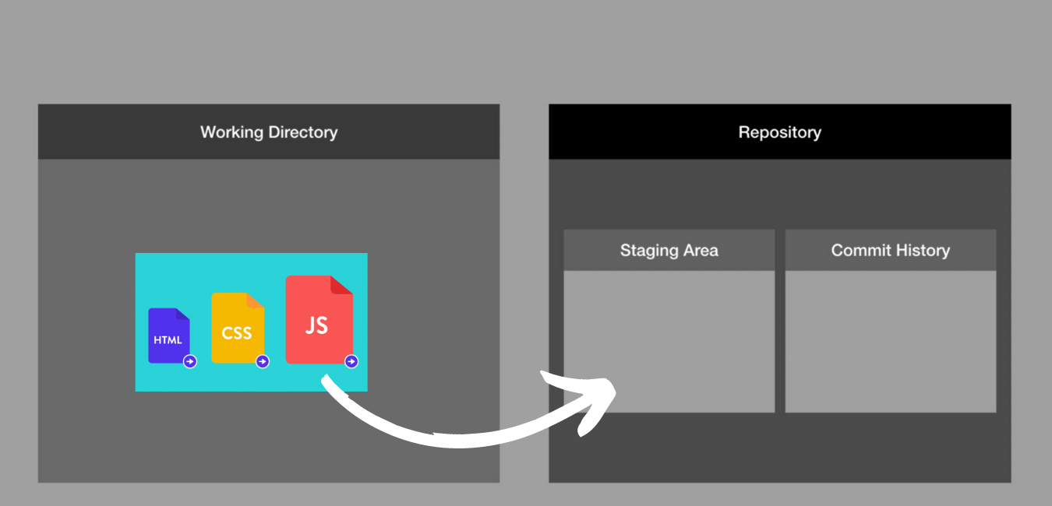
2. git add .

Slide 12
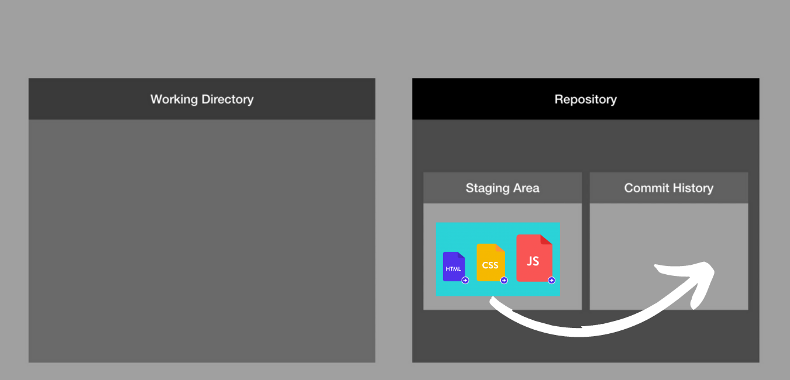
3. git commit

Slide 13

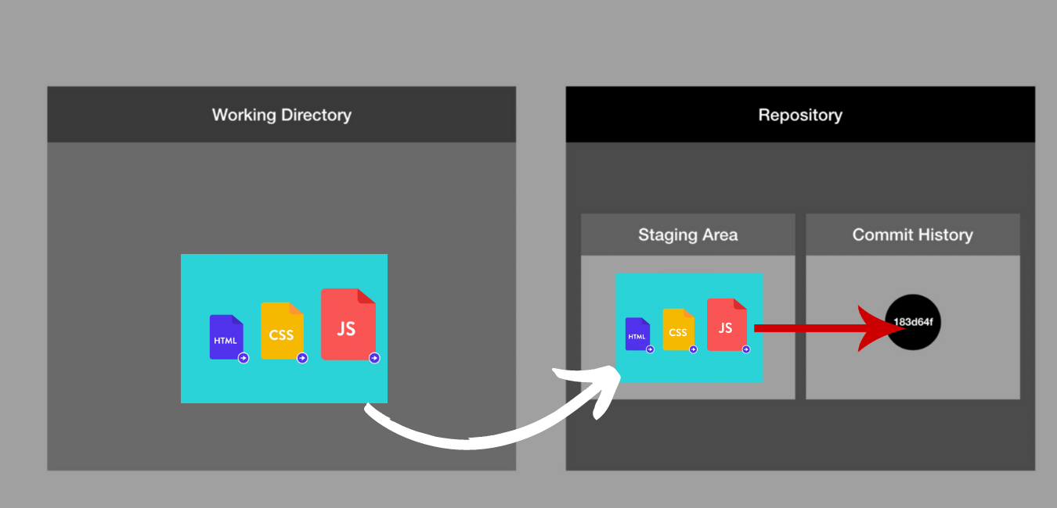
Overall Working
(Project Directory)

Slide 14
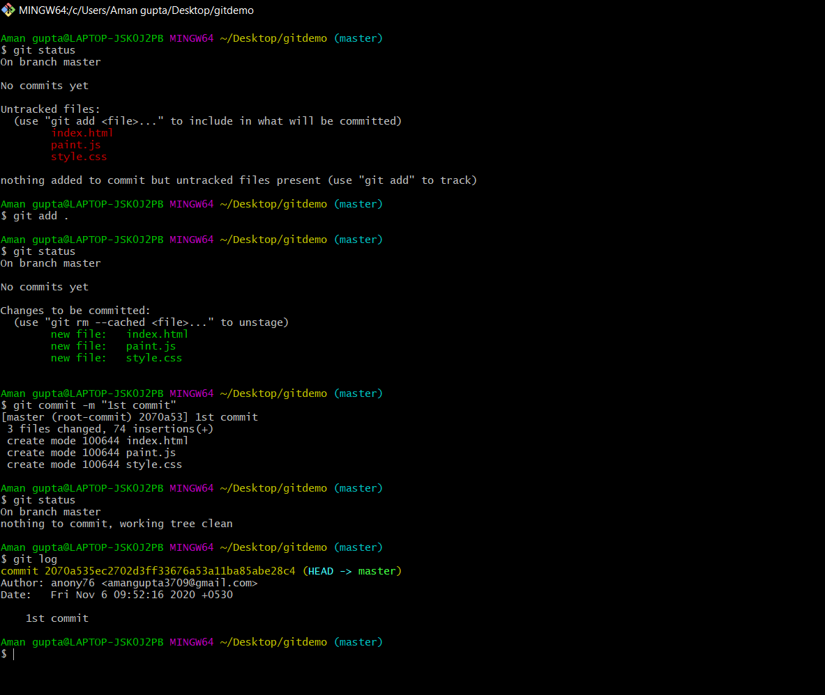
Implementation : Making first commit

Slide 15
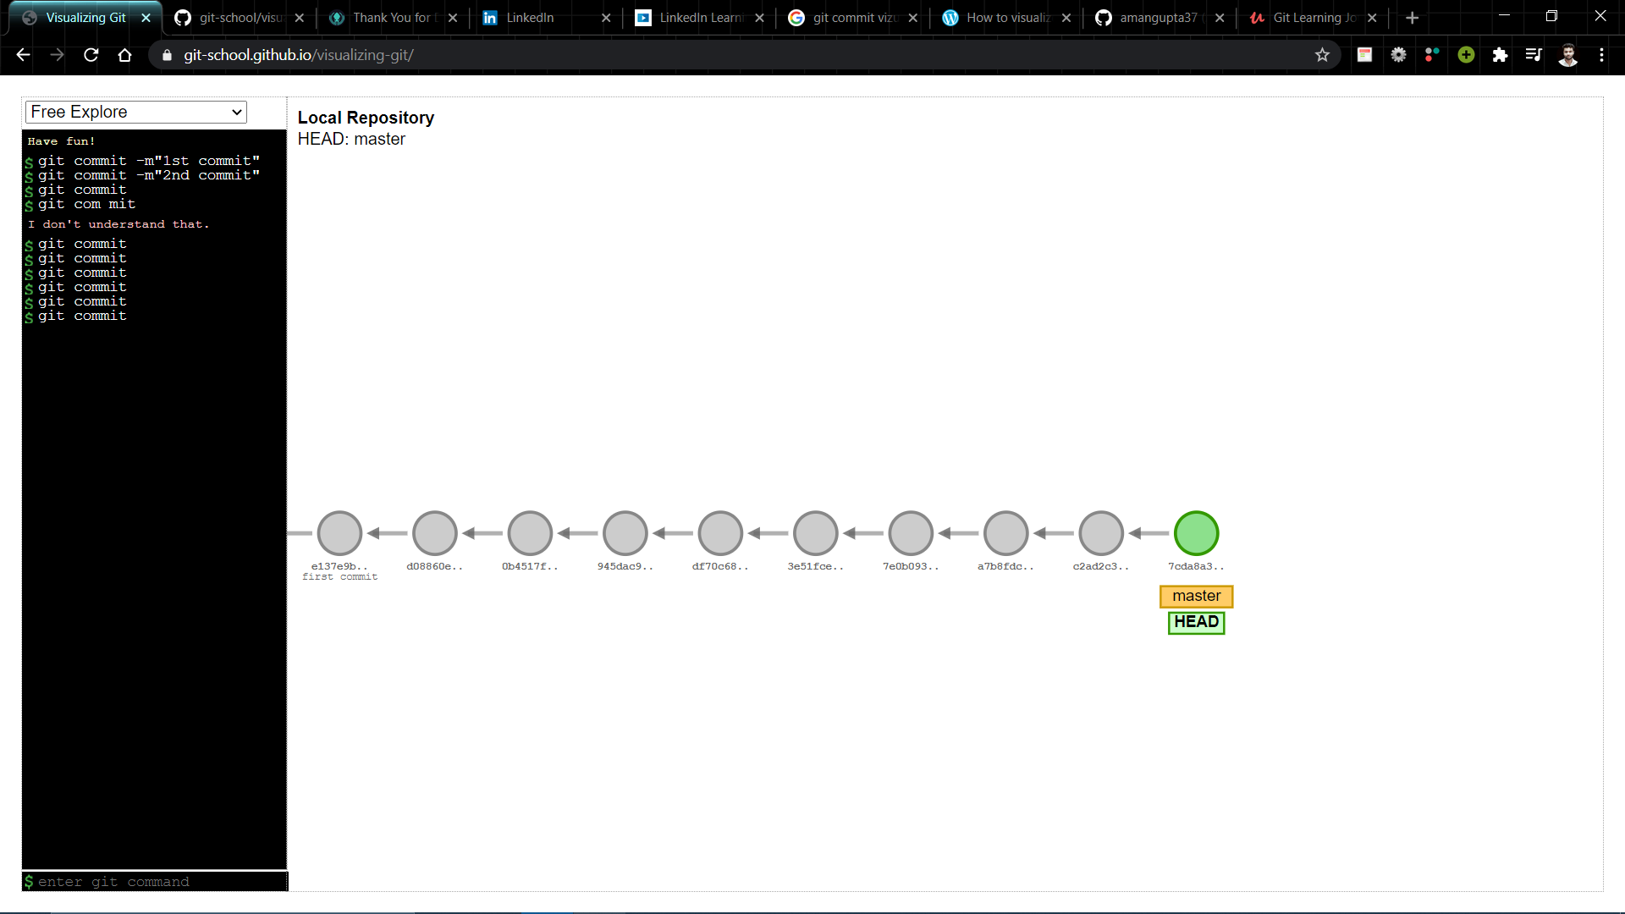
Making Multiple commits
Every commits is recorded in the master branch of the repository.
Every commits forms a Parent- child Relationship.
Each commits has its own unique commit-id
The commit-id is a cryptographic Number created by Secure Hash Algorithm (SHA)
Multiple commits on master branch
Unique commit-id generated through SHA

Slide 16
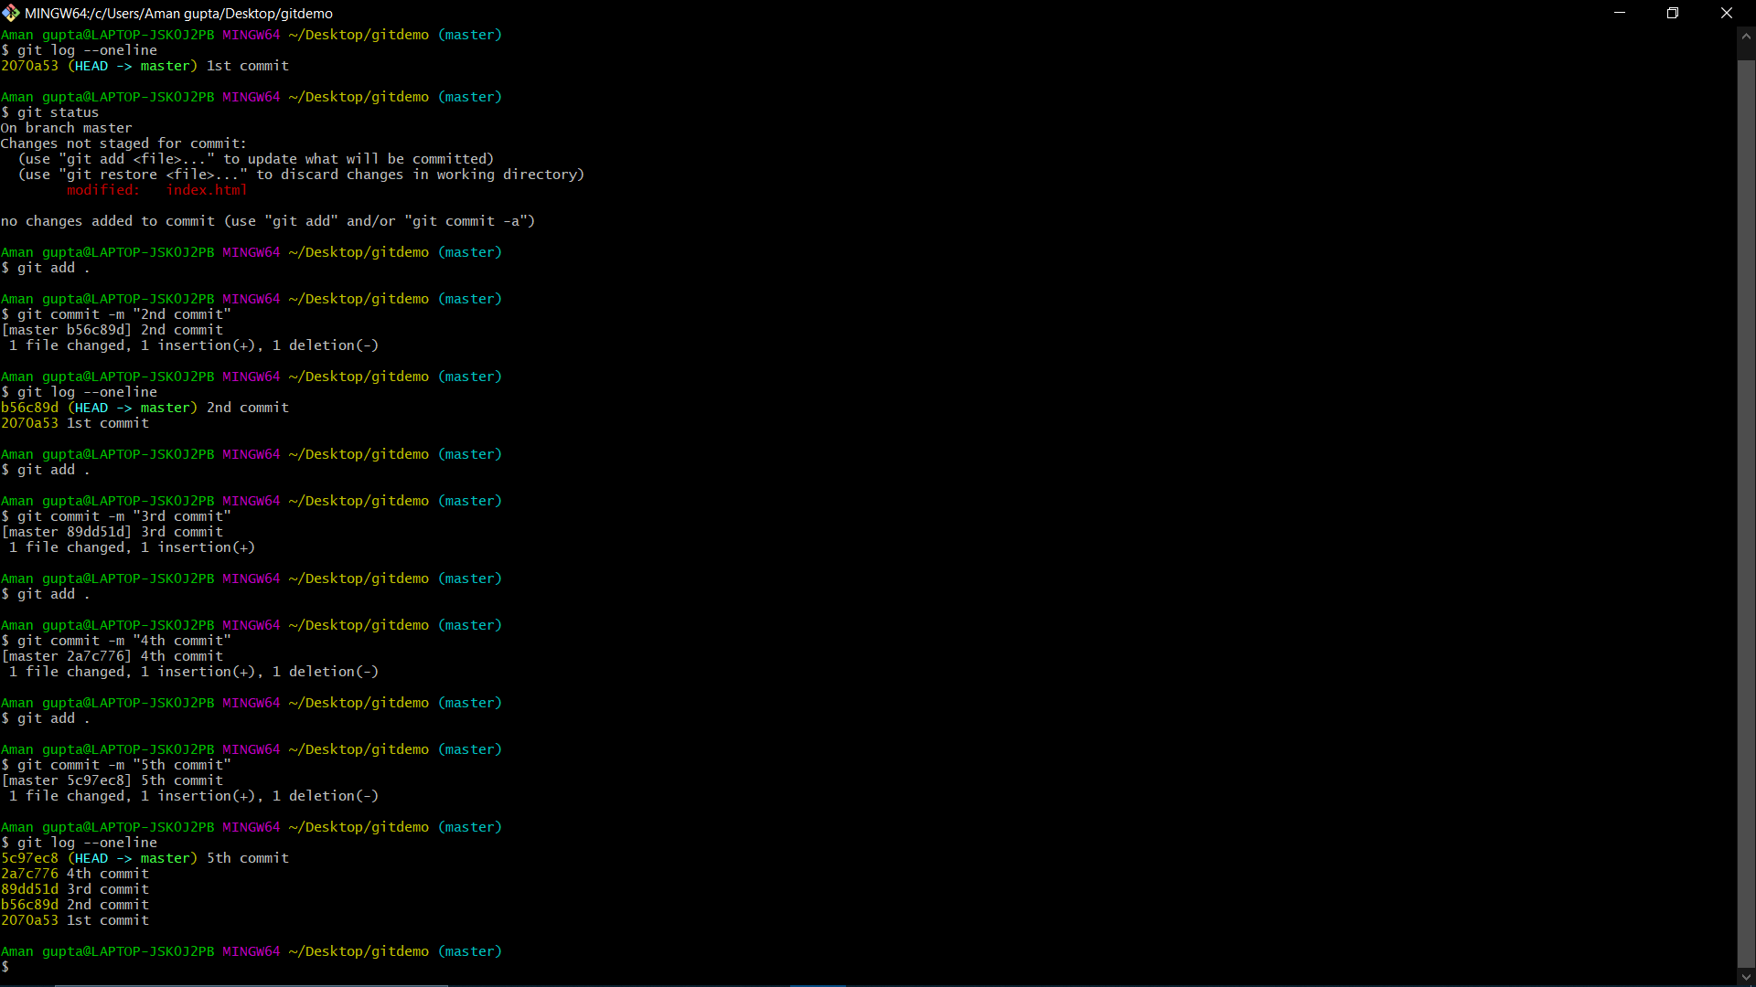
Implementation : Commands for Multiple commits

Slide 17
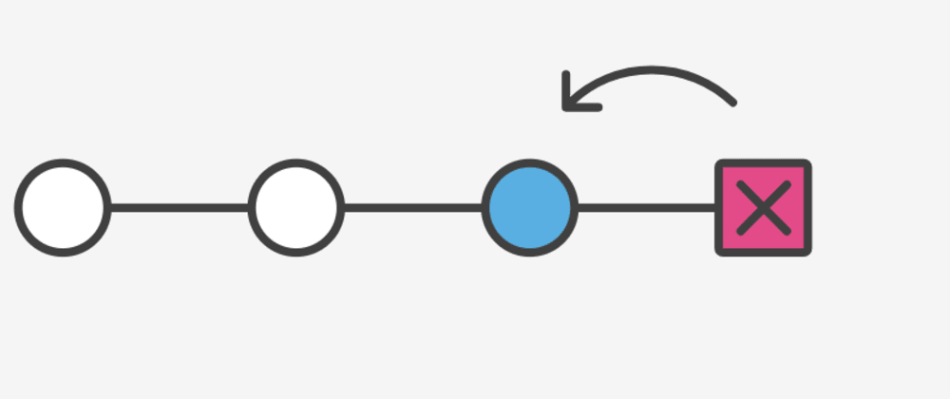
b. Git Undoing
In this topic we will deal with the following commands
Checkout commit
Revert commit
Reset commit

Slide 18
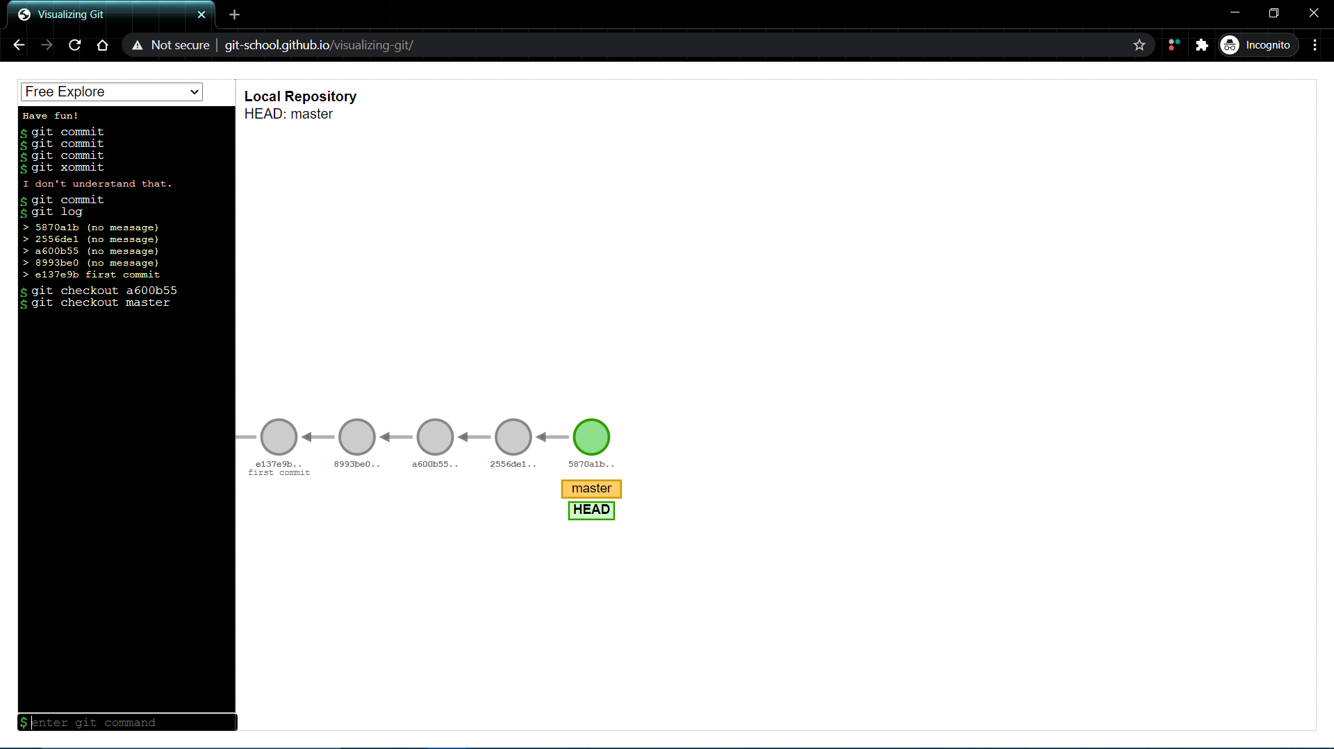
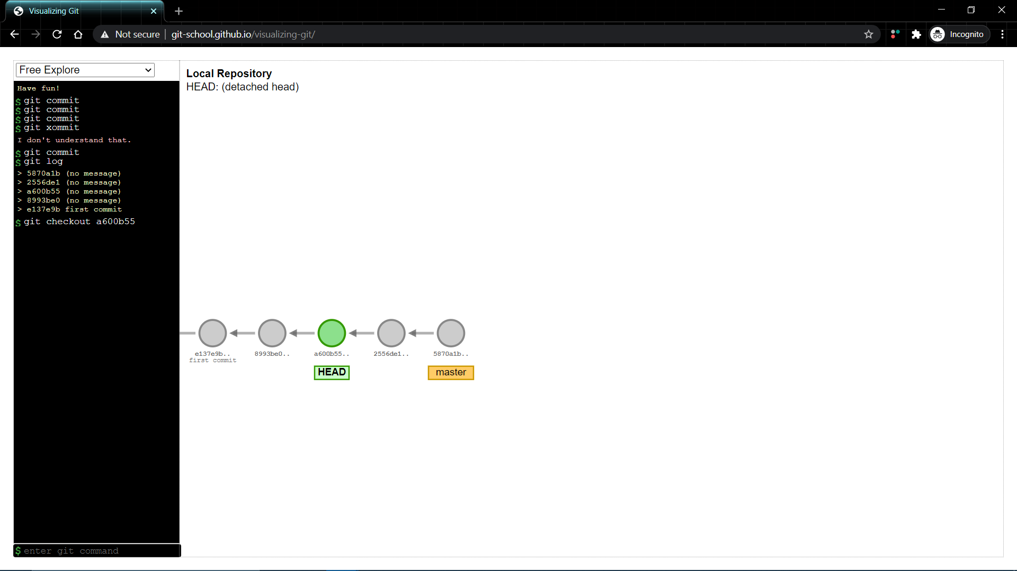
1. Checkout commit
Using git checkout command we can traverse back to the previously made commit
(git checkout a600b5)
Using git checkout for traverse back to 3rd commit

Slide 19
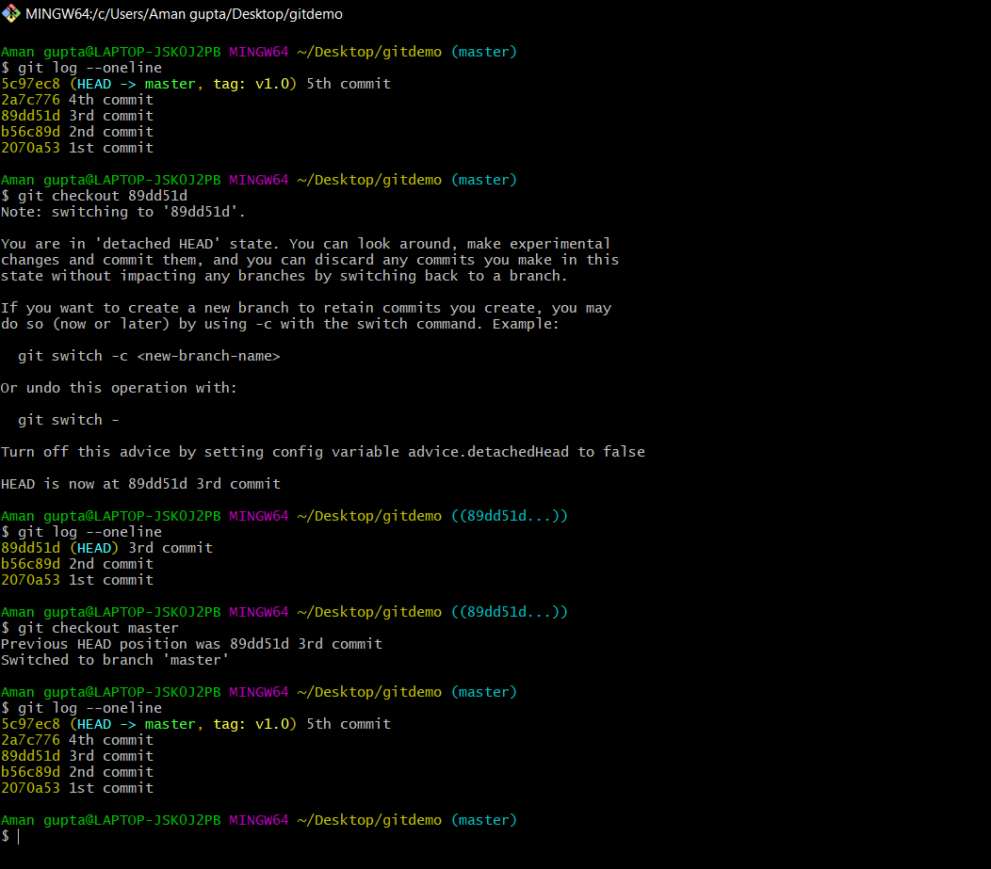
Implementation : Commands for git checkout

Slide 20
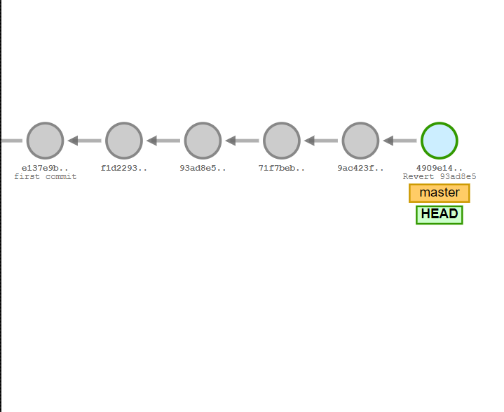
2. Revert commit
The "revert" command helps to undo an existing commit.
It does not delete any data in this process instead, Git will create new changes with the opposite effect - and thereby undo the specified old commit.
git revert 93ad8e5

Slide 21
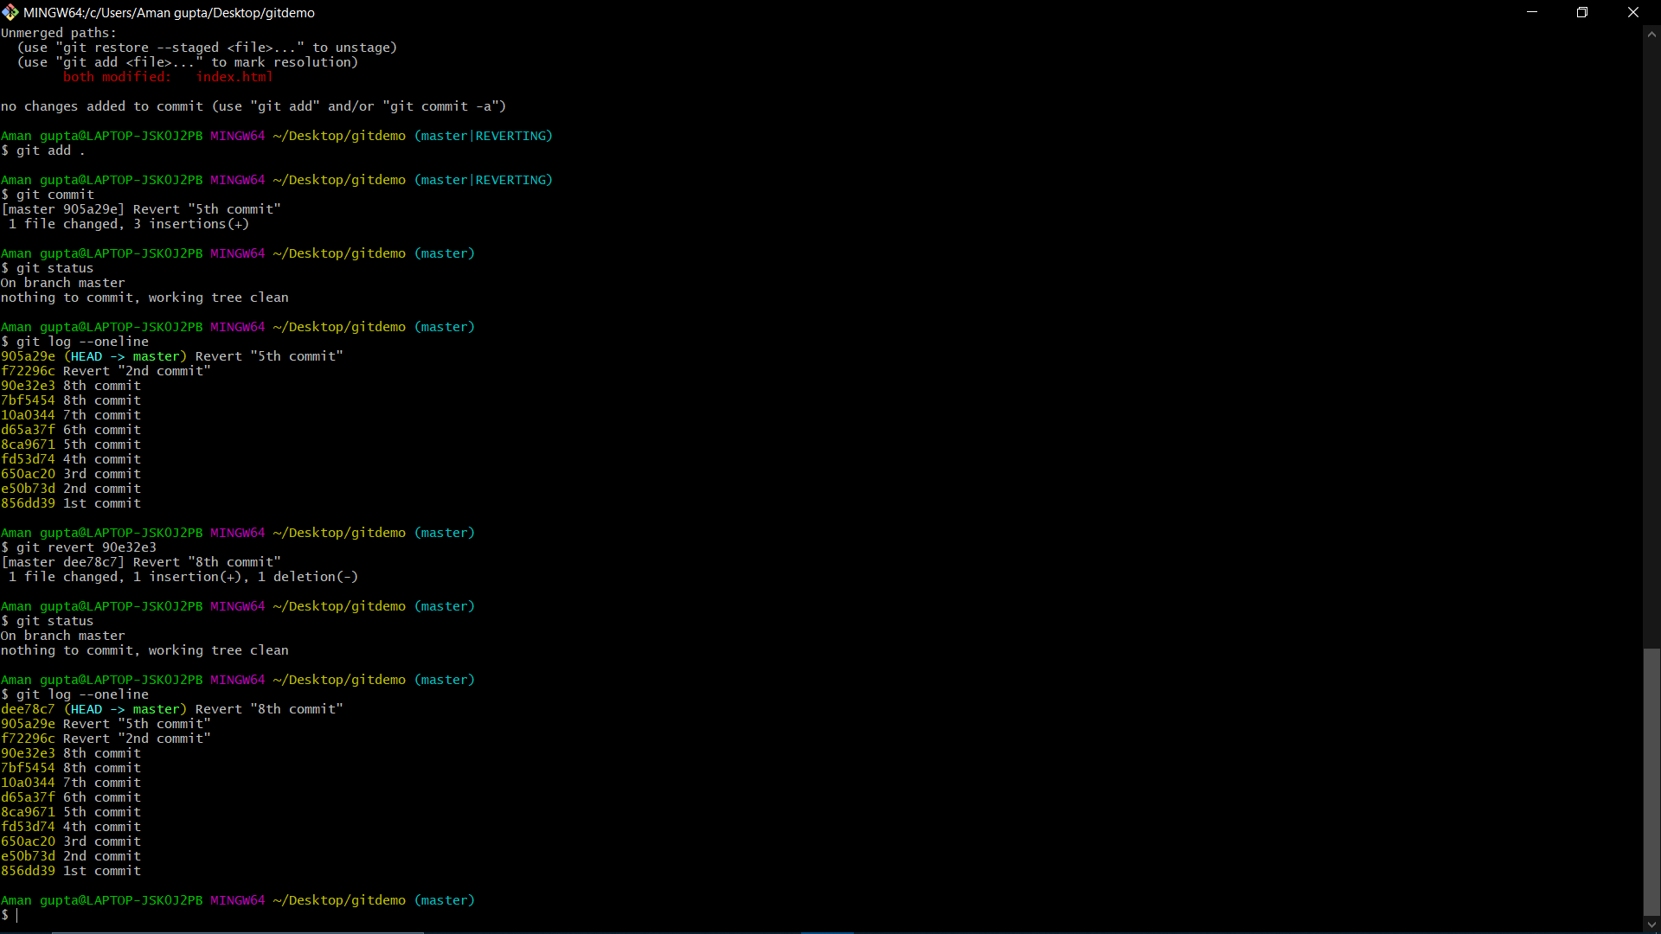
Implementation : Commands for git revert

Slide 22
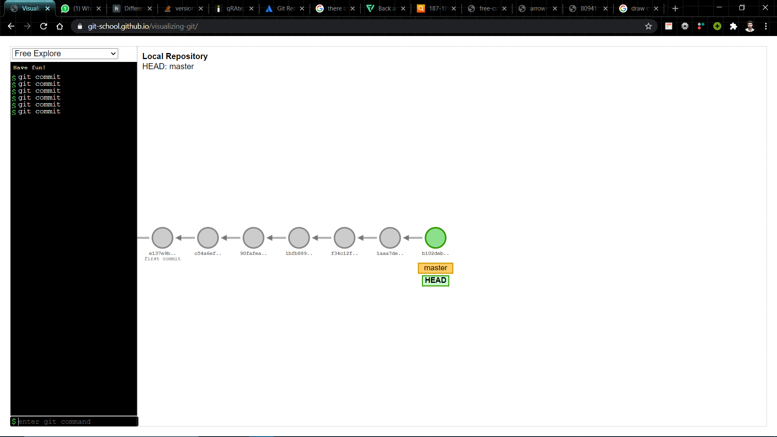
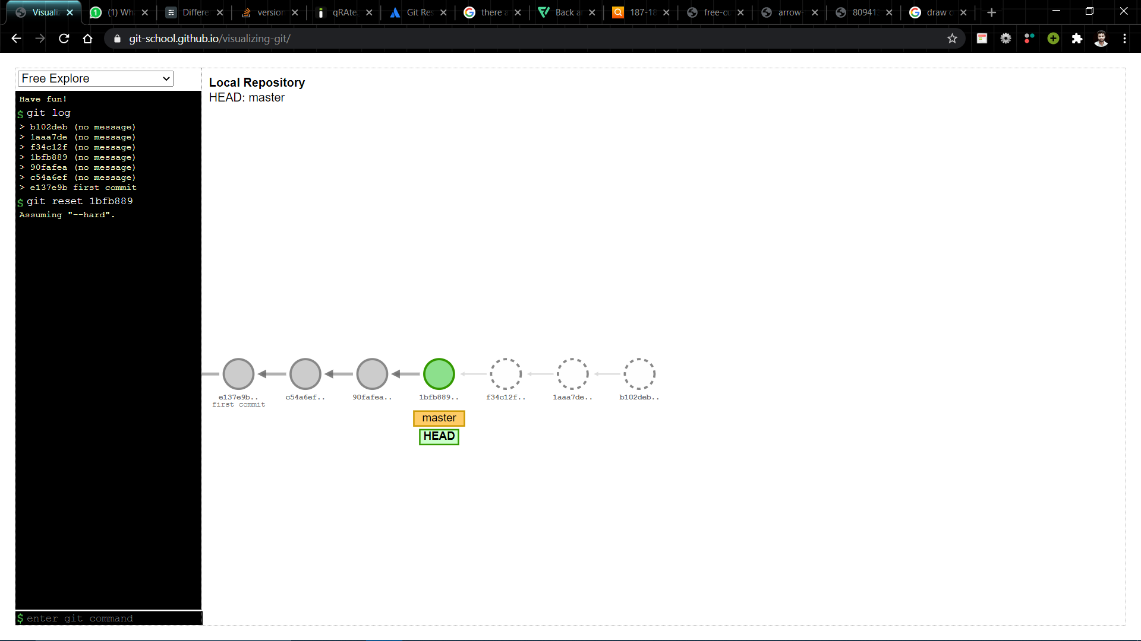
3. Reset commit
git reset is a powerful command that is used to undo local changes to the state of a Git repo.
git reset operates on “Three Trees of git” i.e
Commit History
Staging Index
Working Directory
git reset 1bfb889

Slide 23
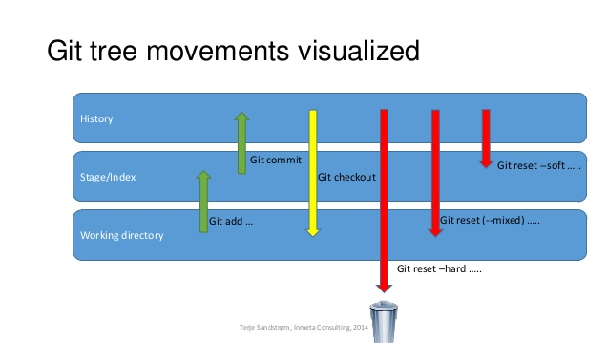
There are three different ways to implement git reset command
Git reset --soft
Git reset --mixed (default)
Git reset --hard

Slide 24



git reset or git reset --mixed
git reset --soft
72b0137b
git reset --hard

Slide 25
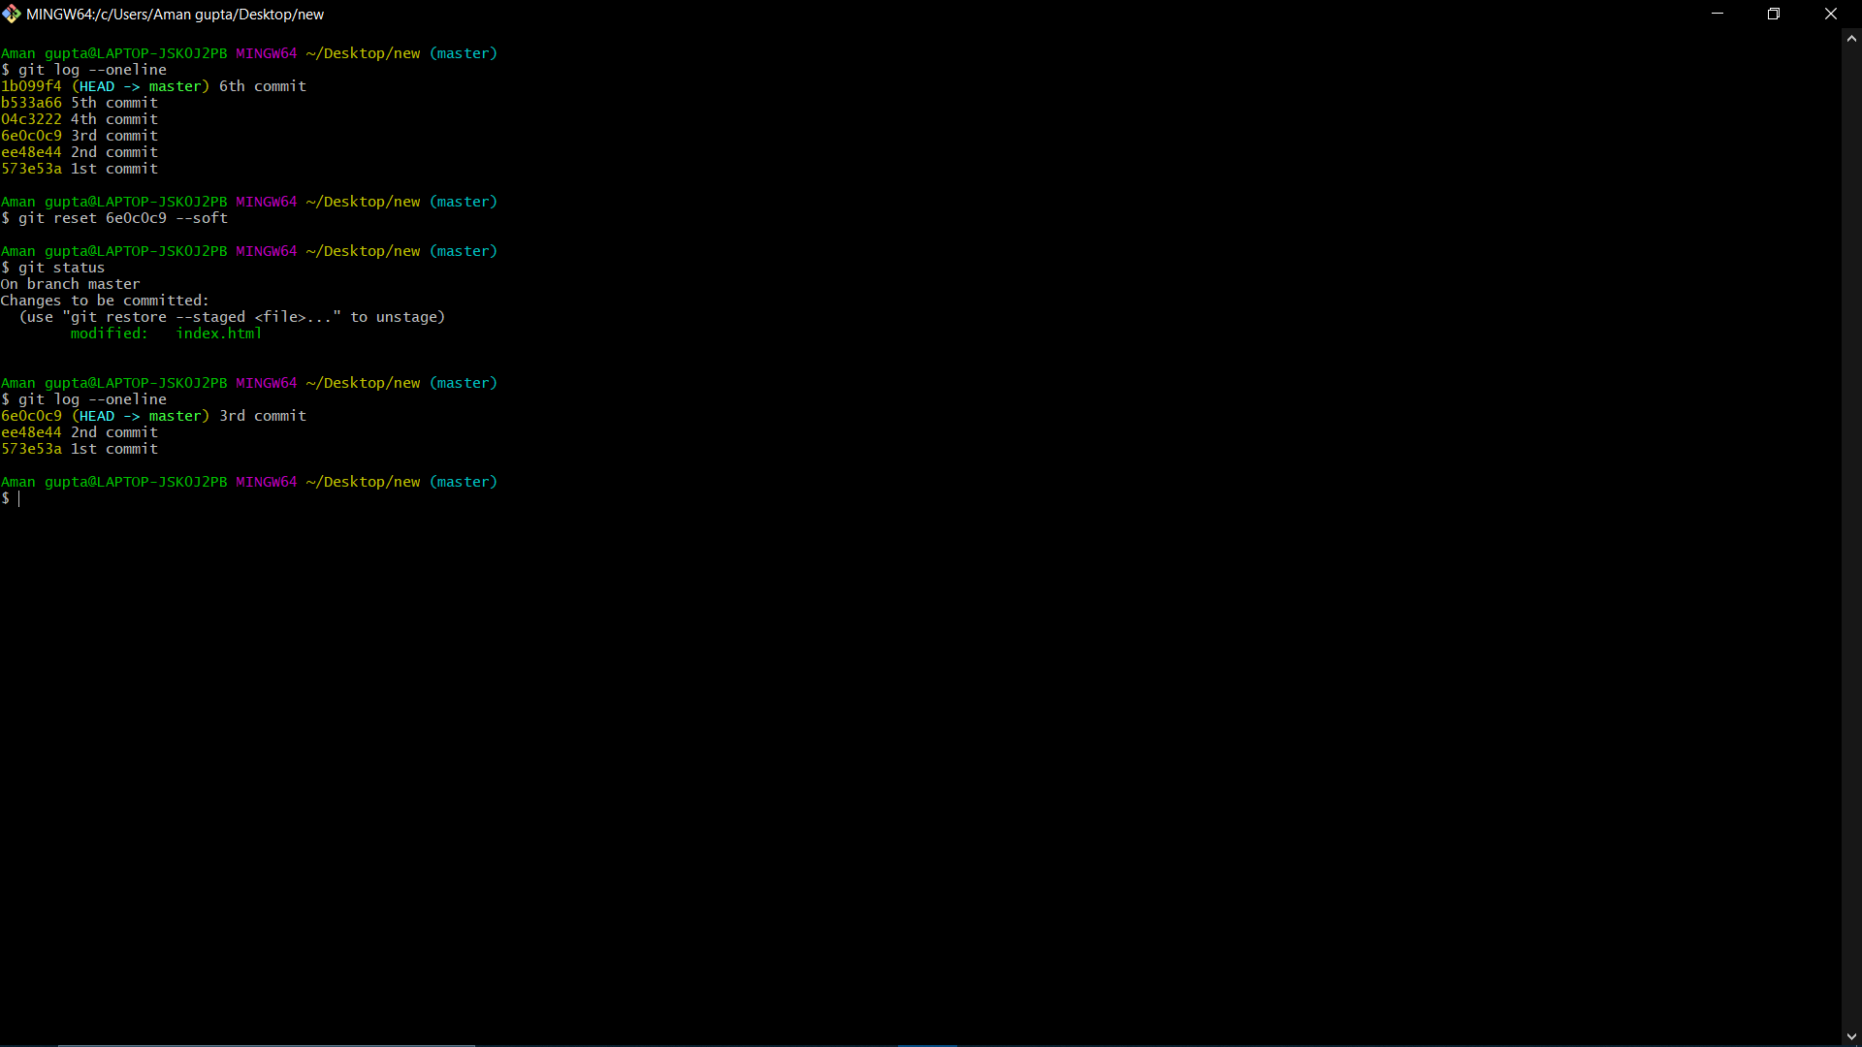
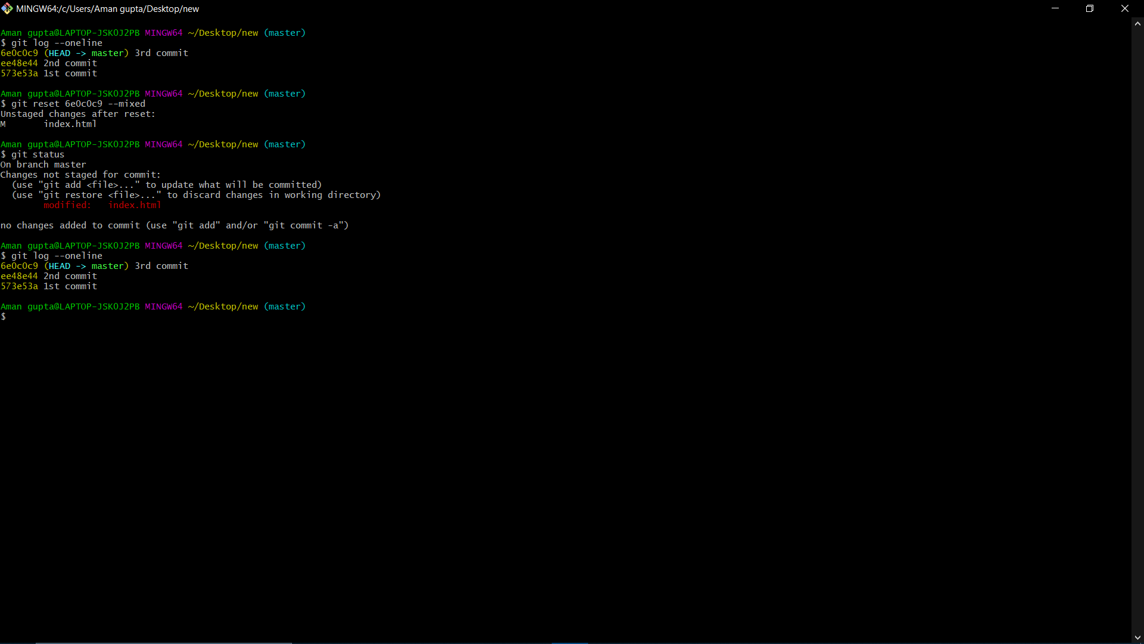
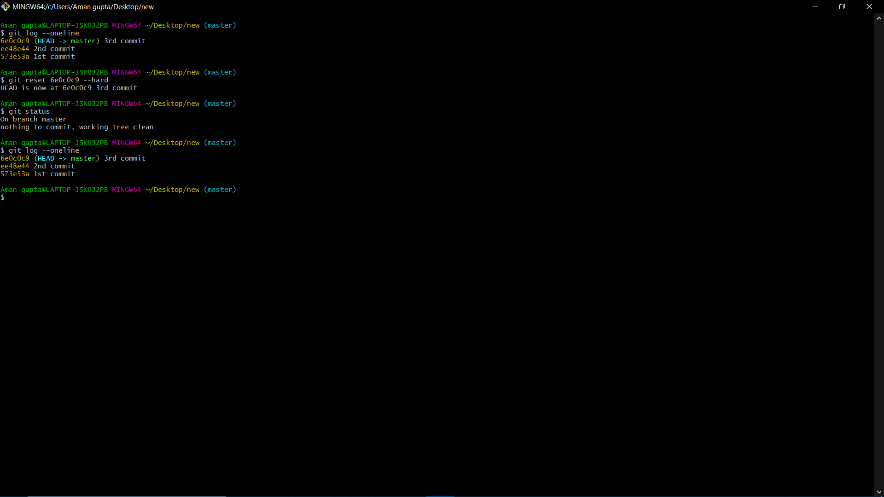
Implementation : Commands for git reset
Git reset --soft
Git reset --mixed
Git reset --hard

Slide 26
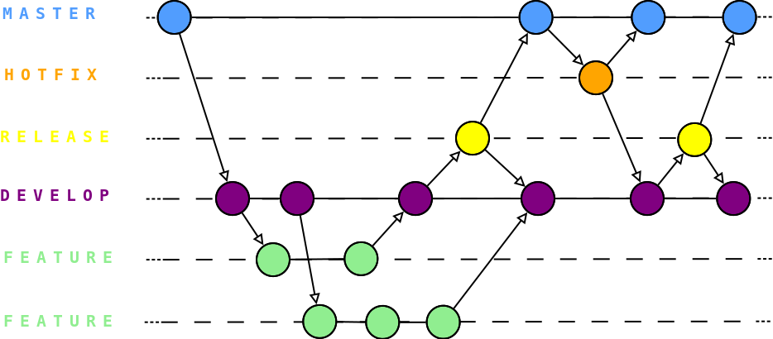
c. Git branching
In this topic we will deal with following commands
Git tag
Git checkout
Git branch
Git log
Click here for Visualization of each command

Slide 27
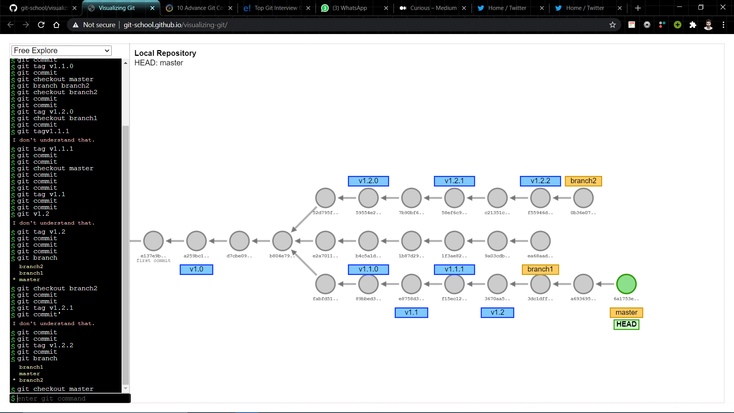
Behind the scene of git branching

Slide 28
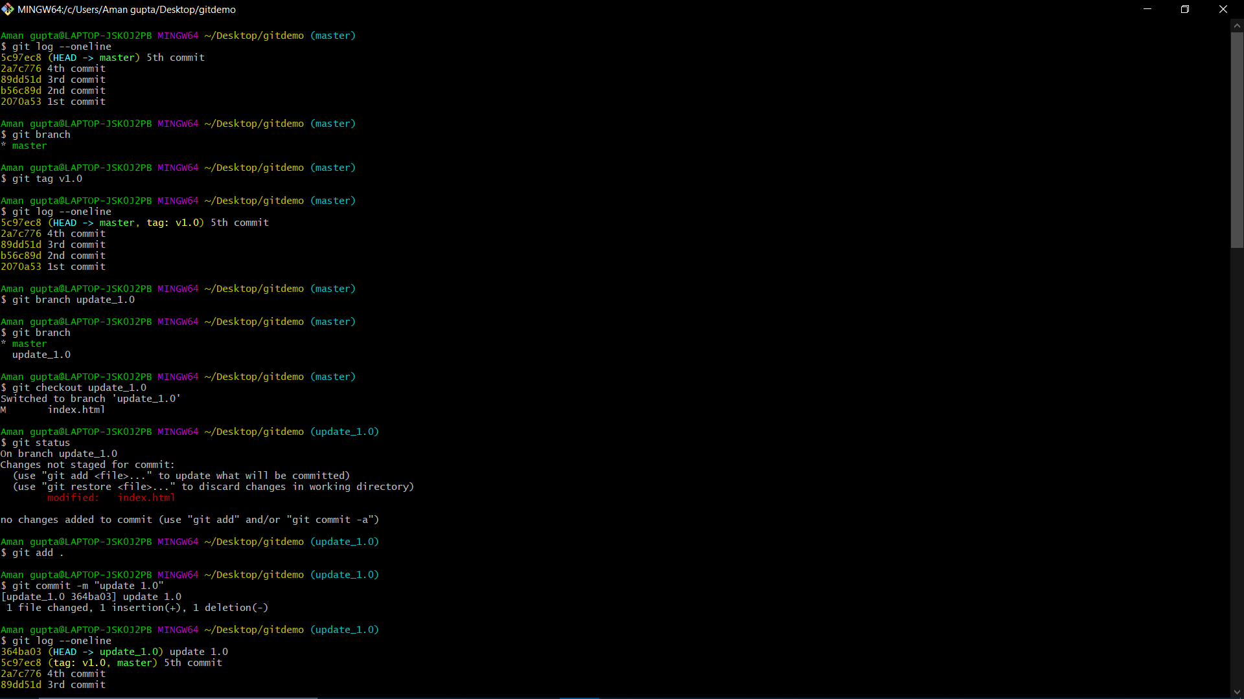
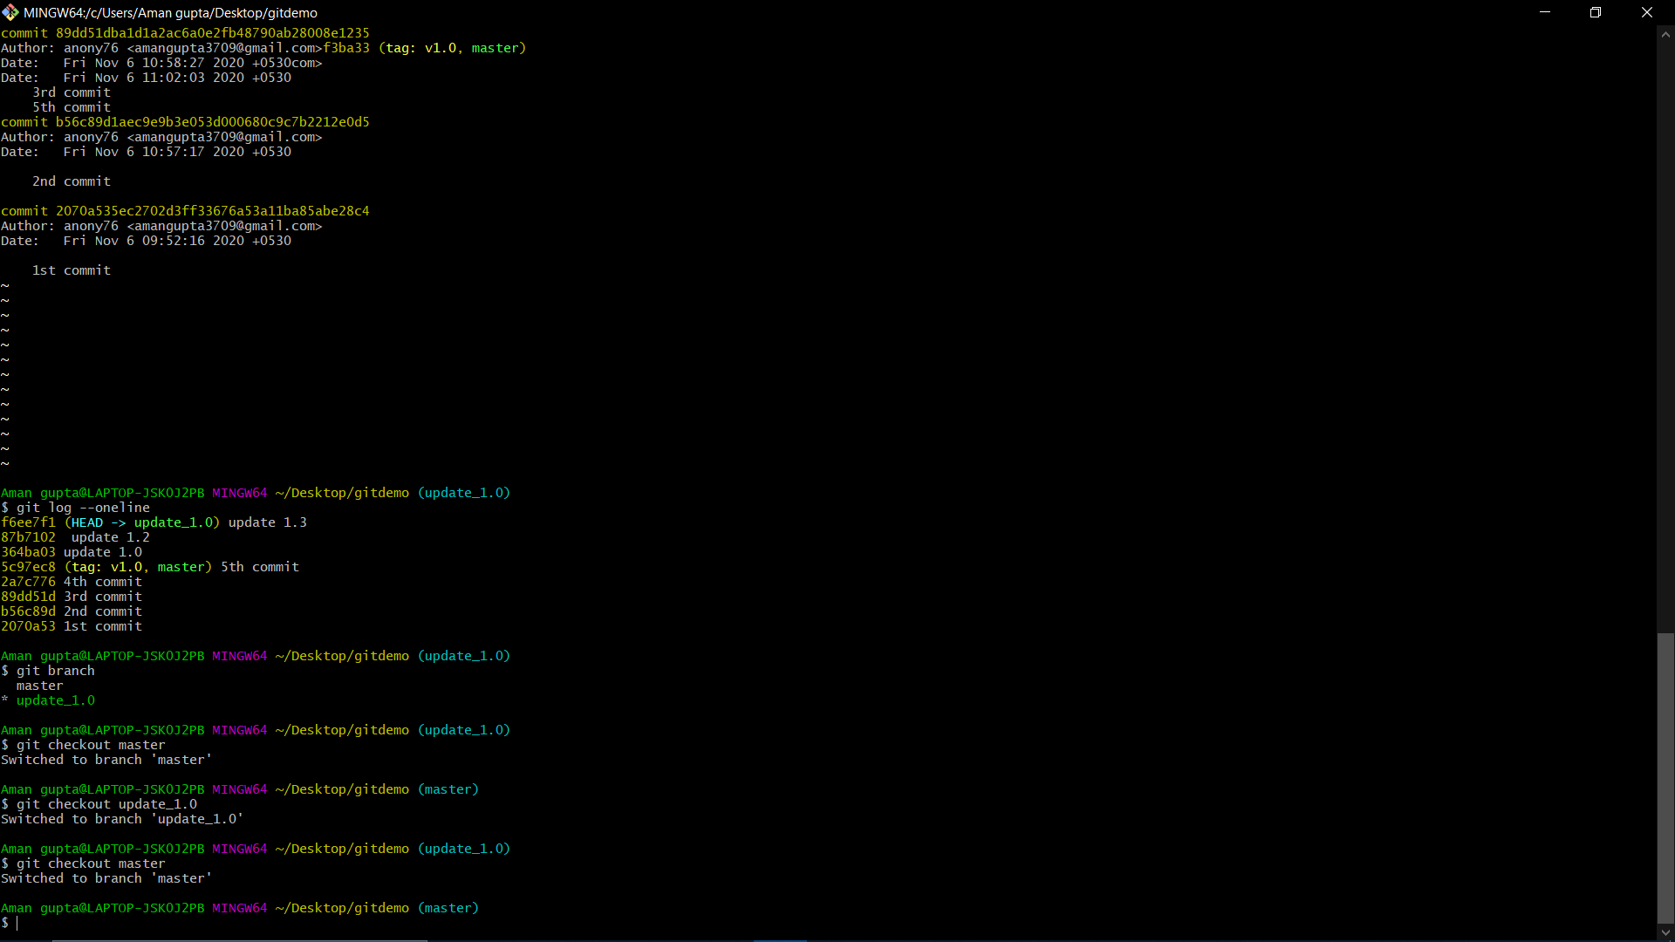
Implementation : Commands for git branching

Slide 29

d. Git Merging
Merging is the process of combining two branches together
There are two main ways of performing git merge operation:
1. Fast Forward Merge
2. Three way Merge
Git can automatically merge commits unless there are changes that conflict in both commit sequences.
Branching and Merging is what makes git incredibly powerful

Slide 30
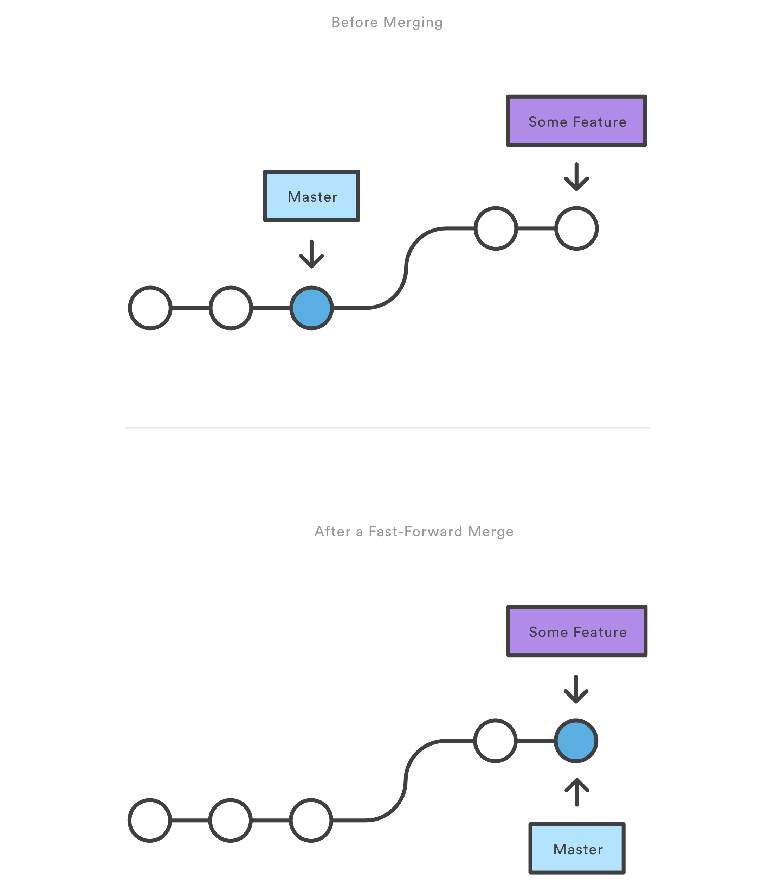
1. Fast Forward Merge
A fast-forward merge can occur when there is a linear path from the current branch tip to the target branch.
fast-forward merge is not possible if the branches have diverged. Then we use 3-way merge method to perform merging operation.

Slide 31
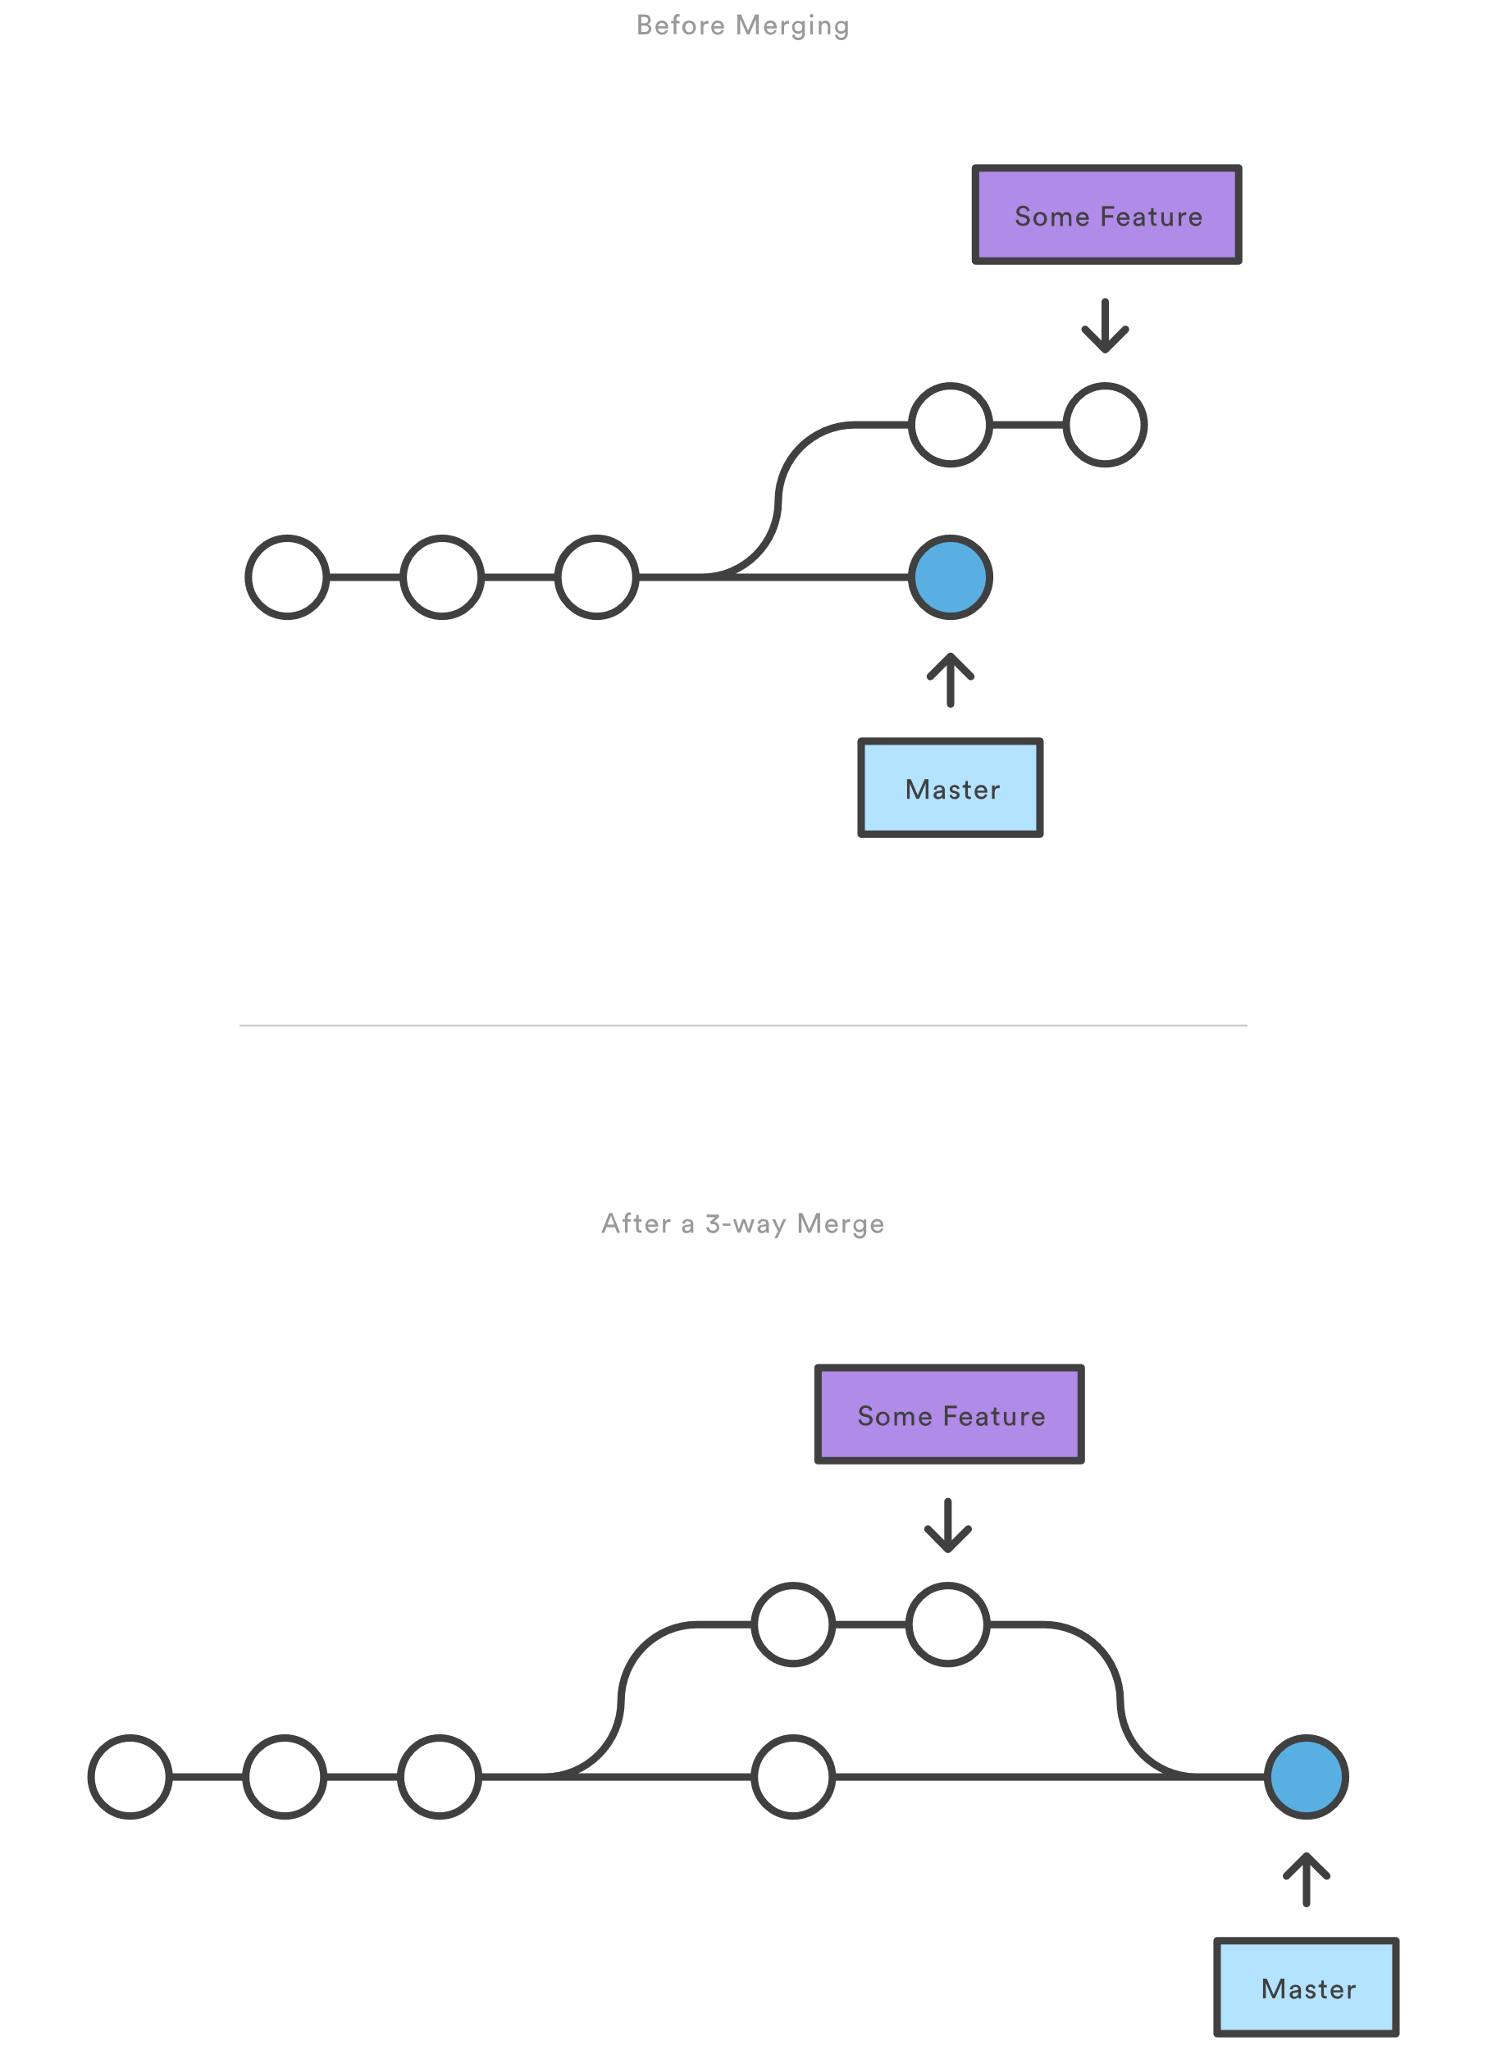
2. Three way Merge
A three way merge can occur when there is no linear path from the current branch tip to the target branch.
It’s a most common way of achieving merge operation.

Slide 32
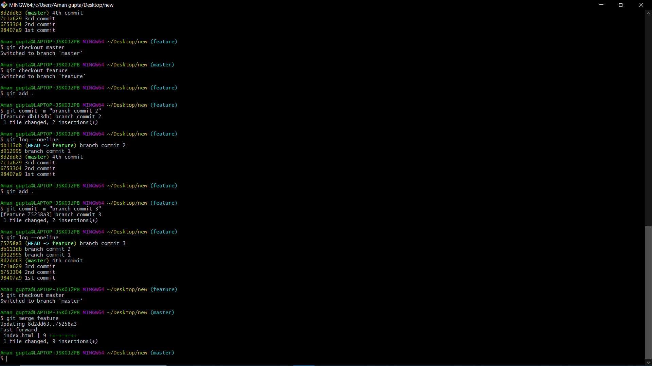
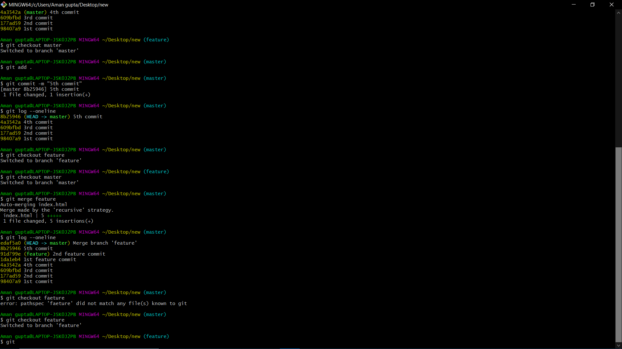
Implementation : Commands for git branching
Fast Forward Merge
Three way Merge

Slide 33
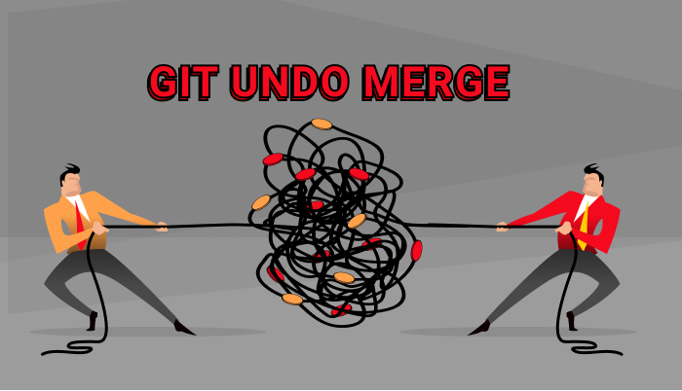
Undo merge commit
There are basically two most efficient method to perform undo in merge commit
git reset
git revert

Slide 34
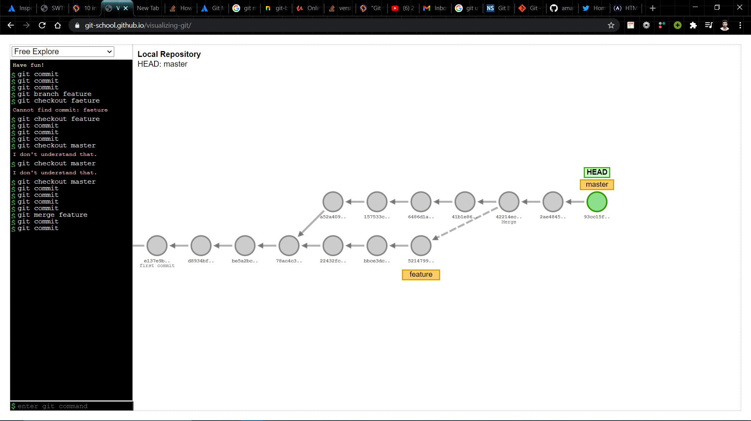
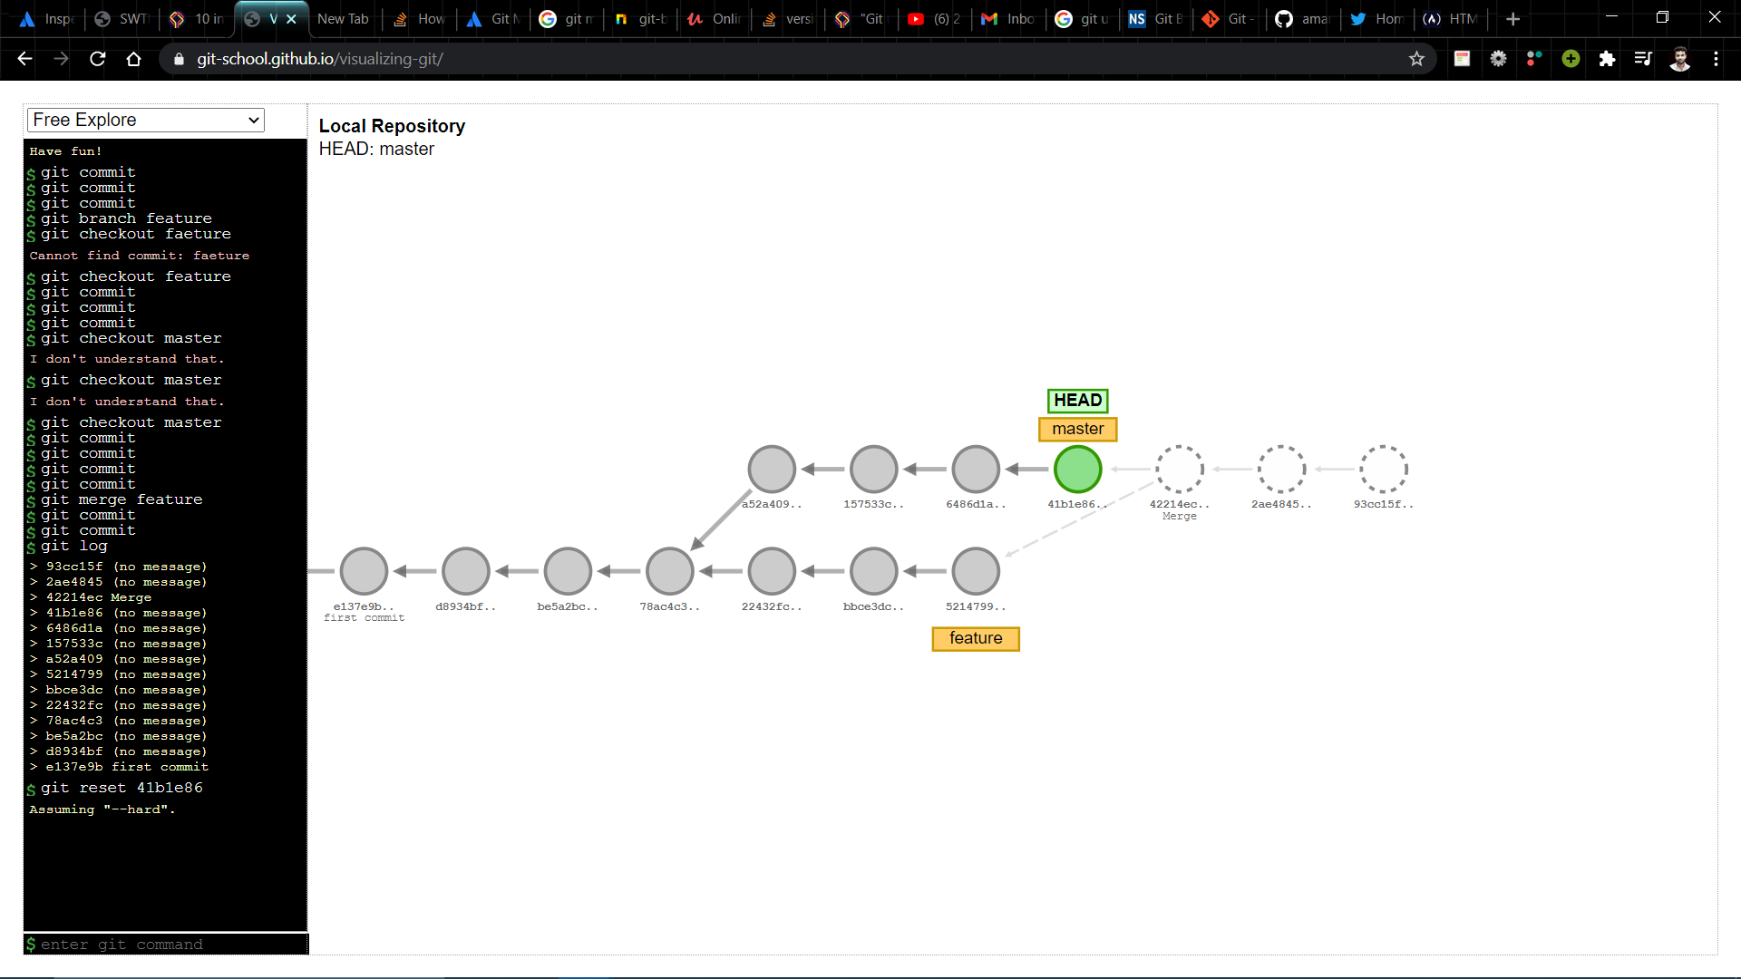
1. git reset
Branch Before undo merge commit
git reset --hard can be used to permanently delete the merged commit and hence it’s a very powerful and risky command to perform undo merge commit operation.
(git reset 41b1e86 –hard)
Branch After undo merge commit

Slide 35
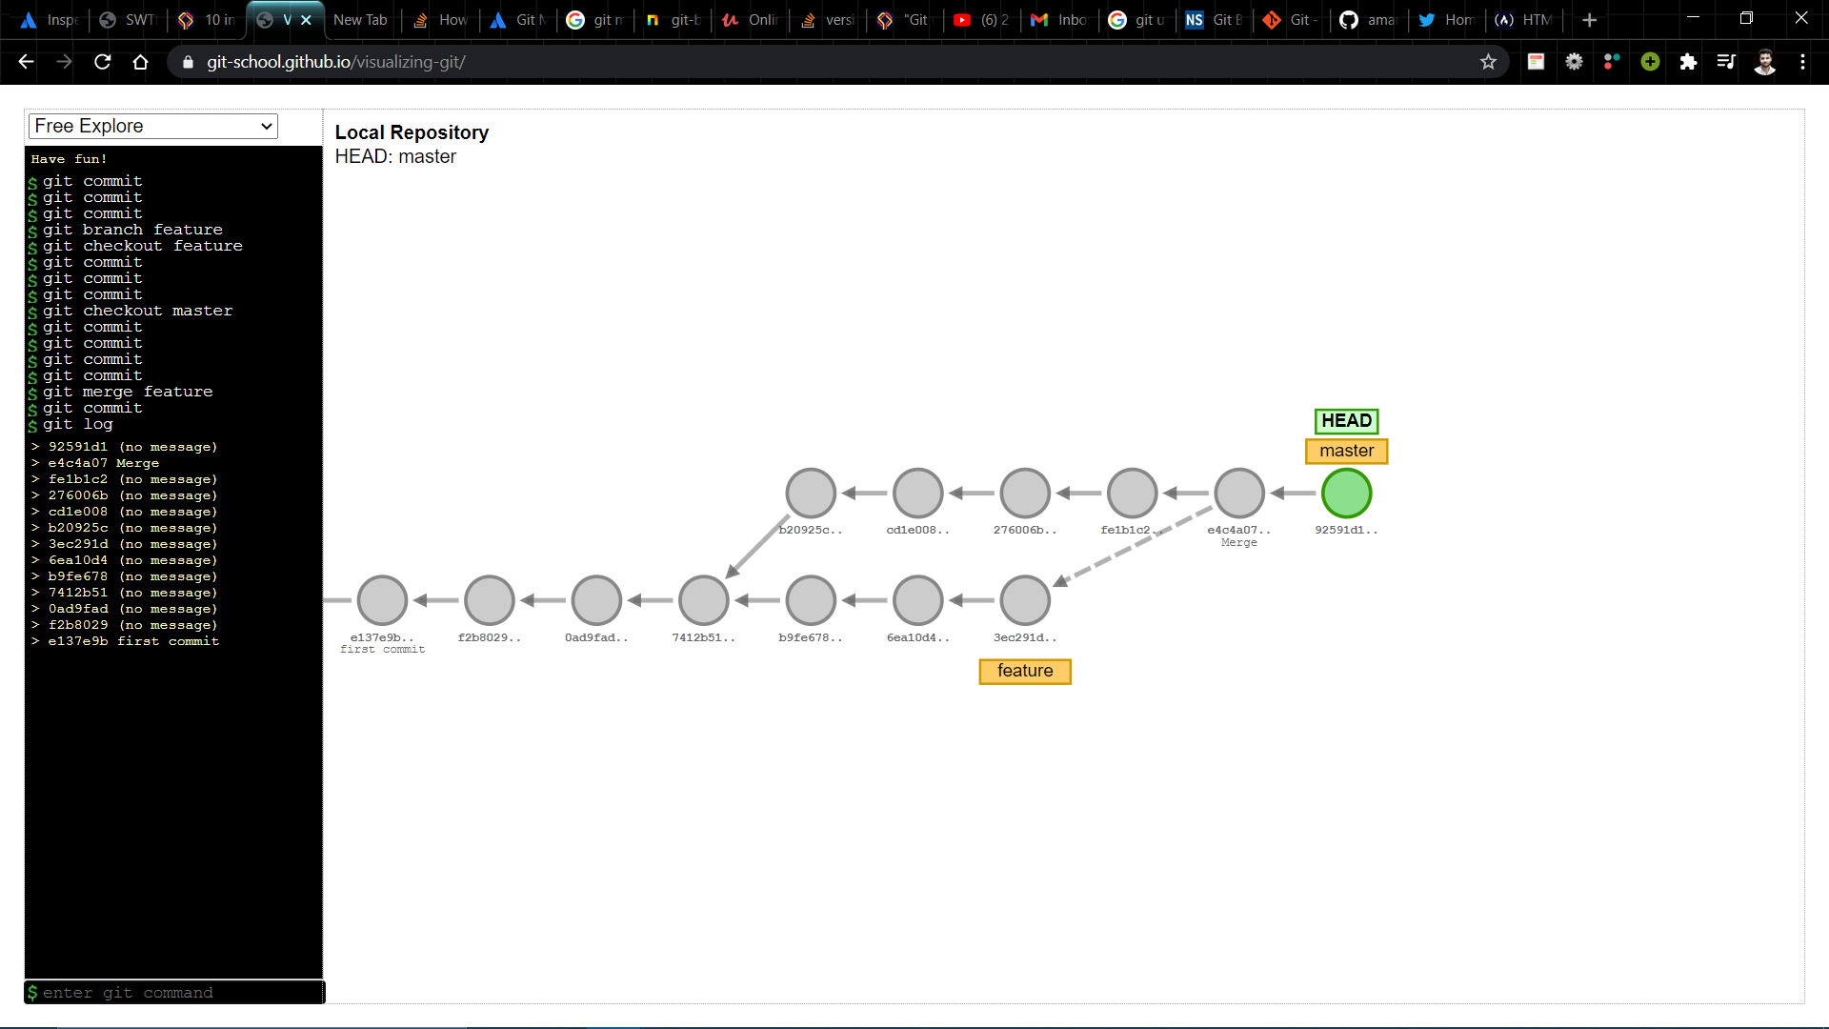
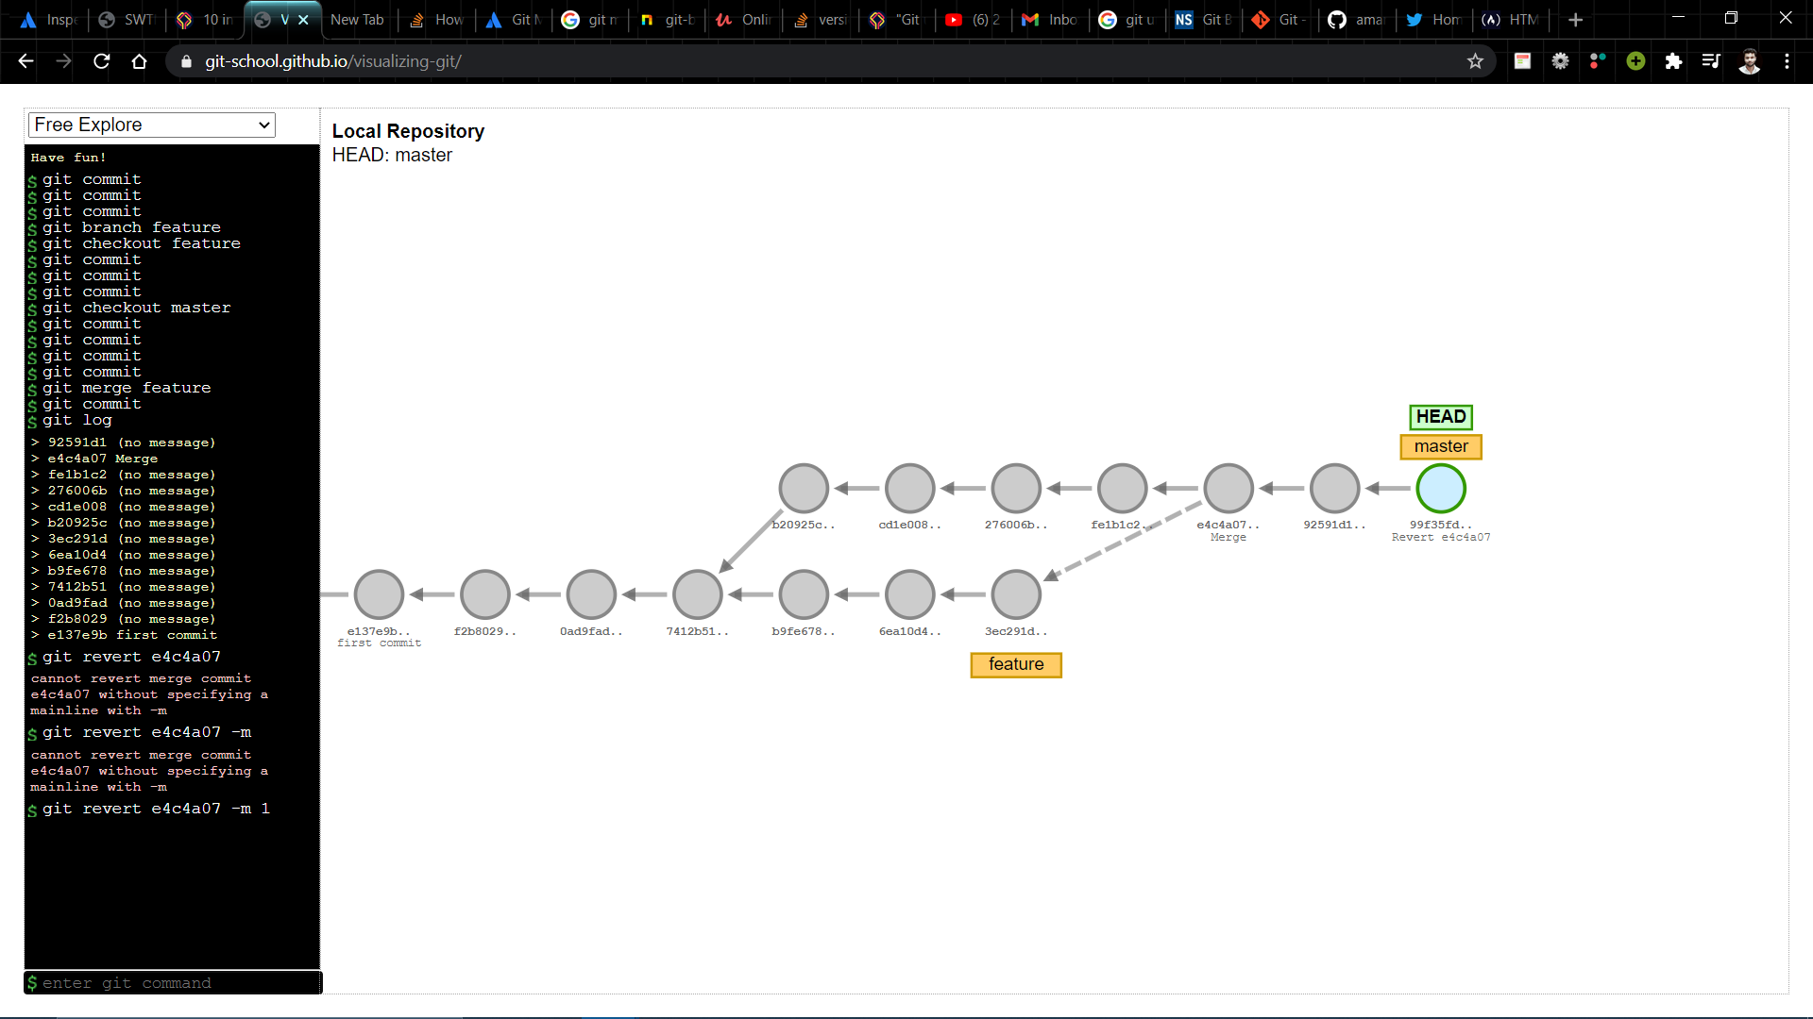
2. git revert
Git revert is considered to be the best option when it comes to performing undo merge commit because it does not delete any commits
(git revert e4c4a07 –m 1)

Slide 36
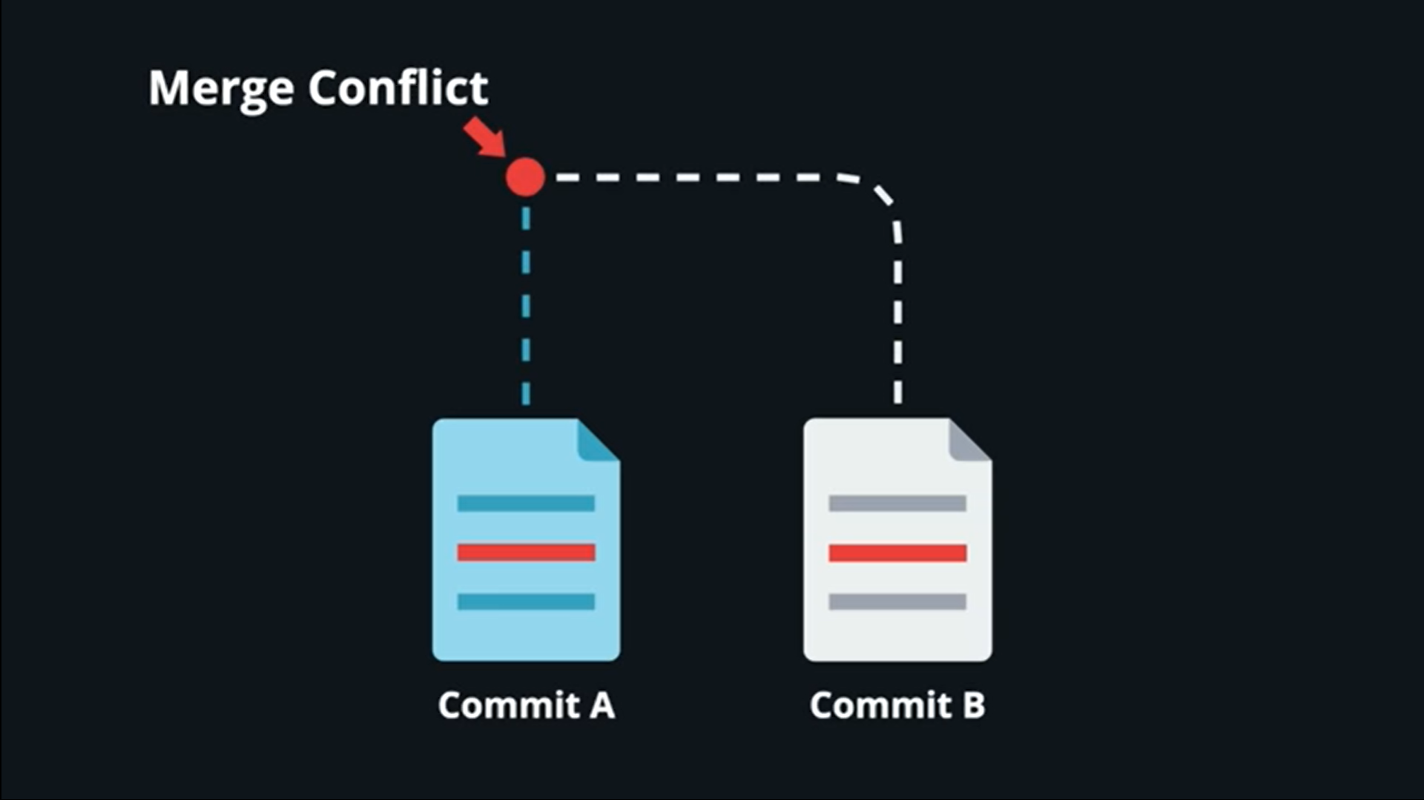
Merge Conflict
Merge Conflict is an event that occurs when git is unable to automatically resolve difference in code b/w two commits.
Conflicts can occurs while
Merging a Branch
Rebasing a Branch
Cherry Picking

Slide 37
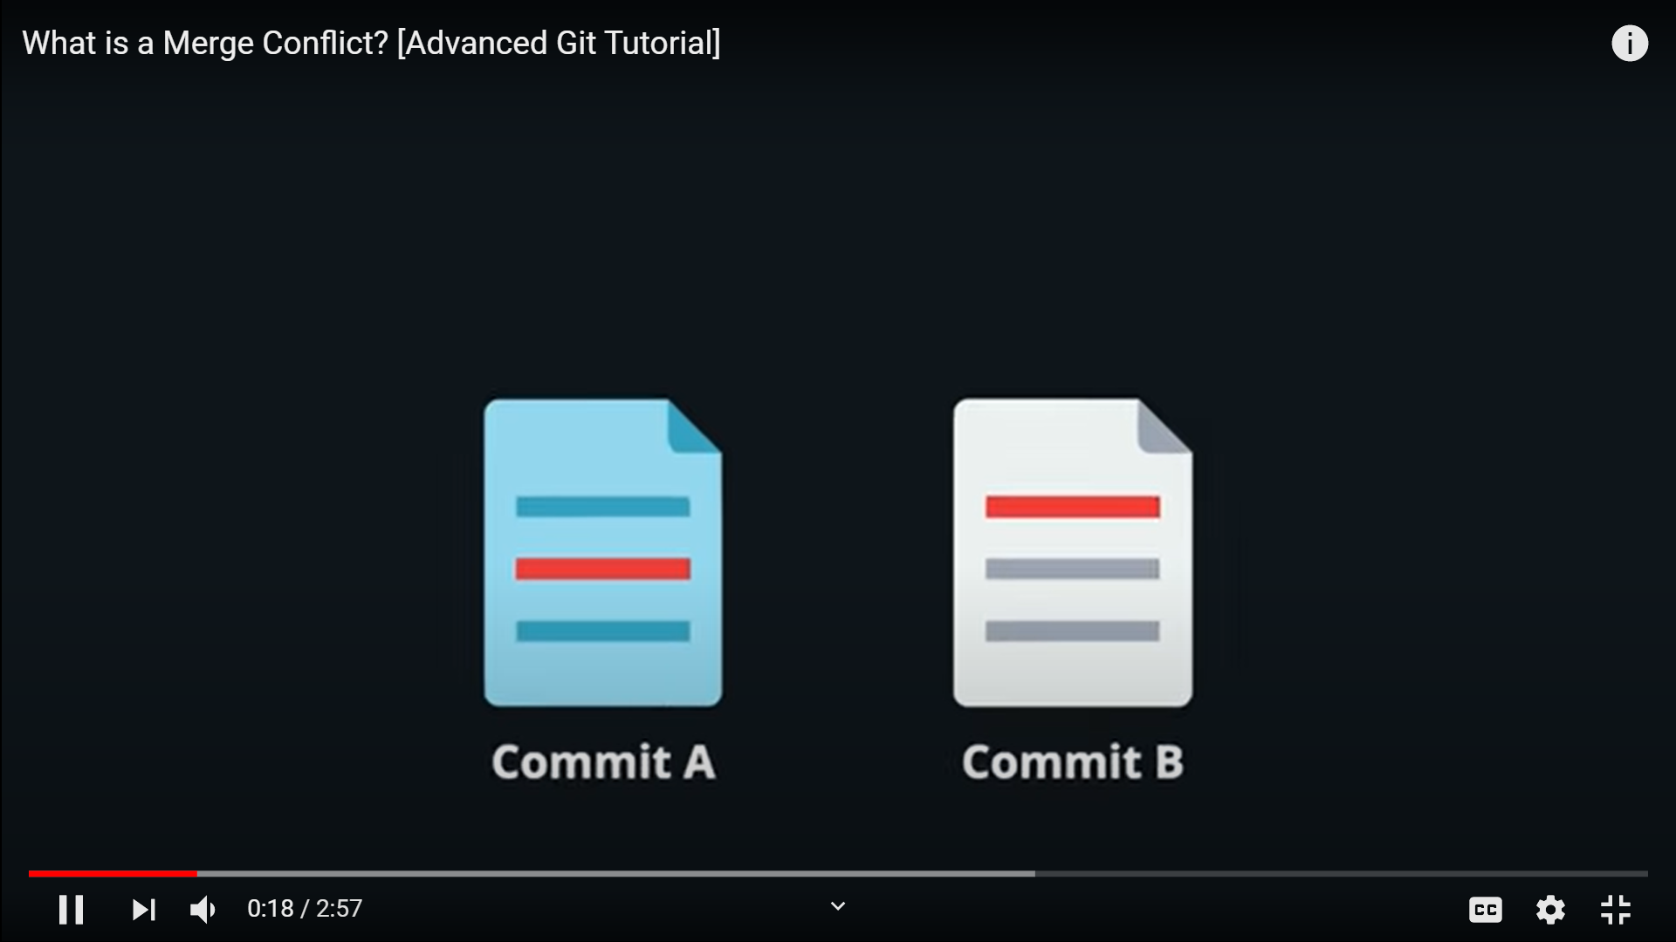
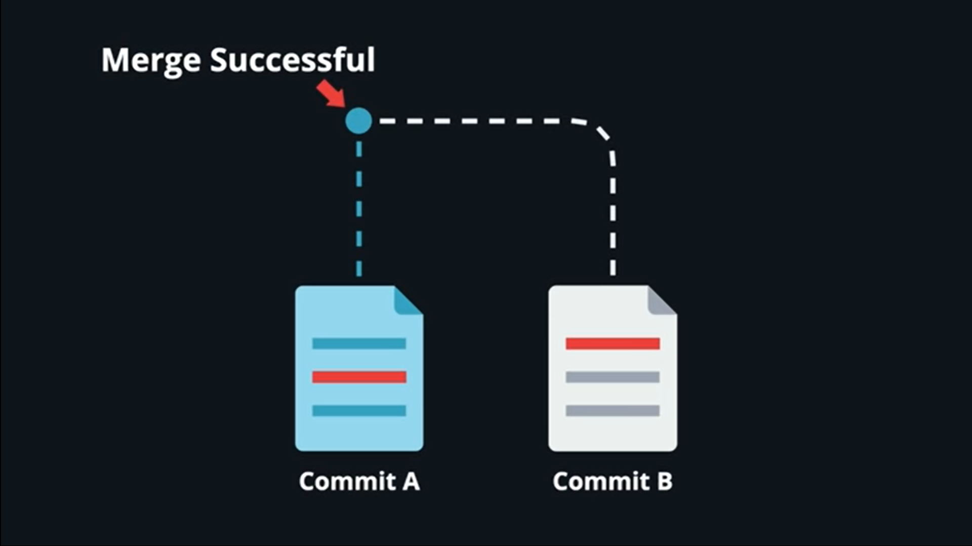
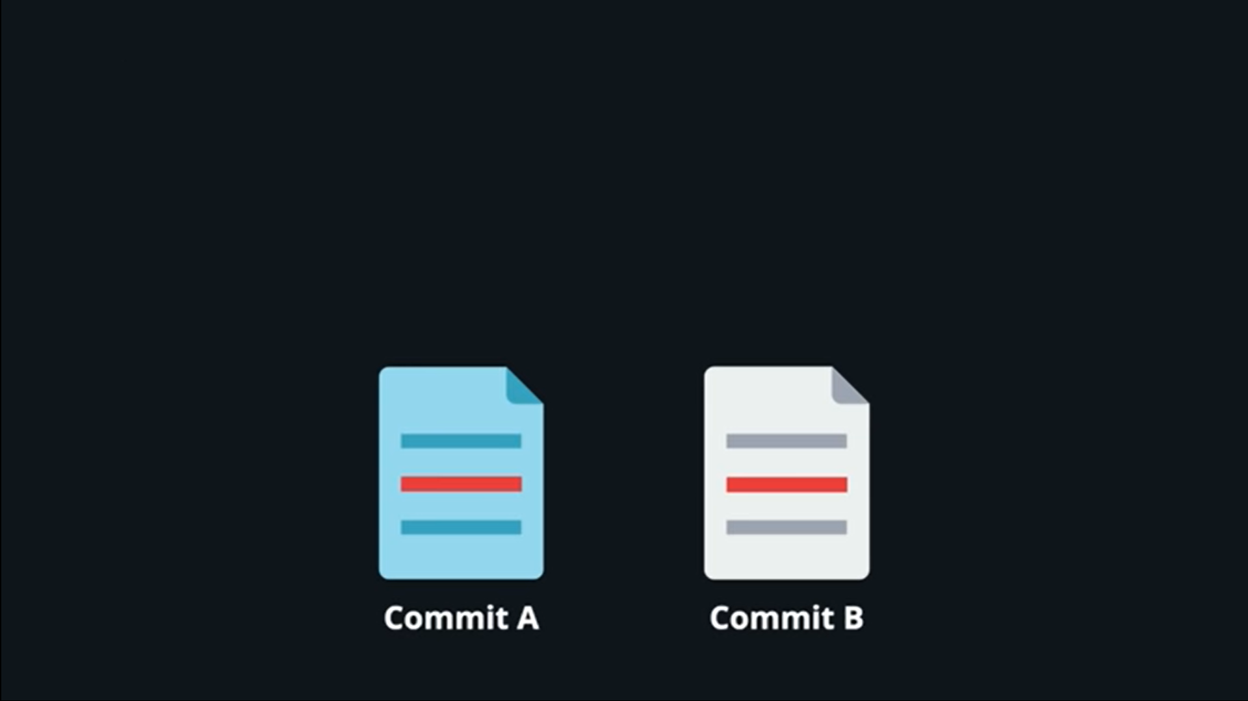
(git merge commit B)
(git merge commit B)

Slide 38
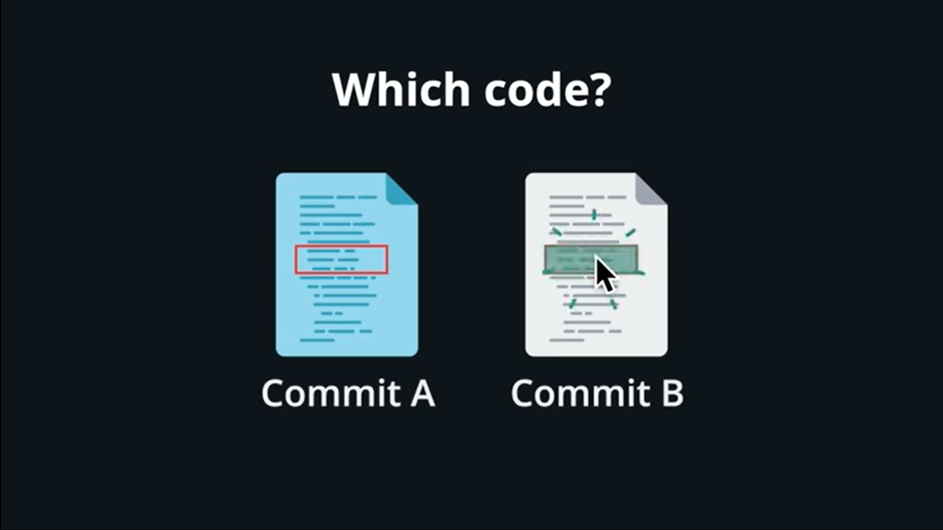
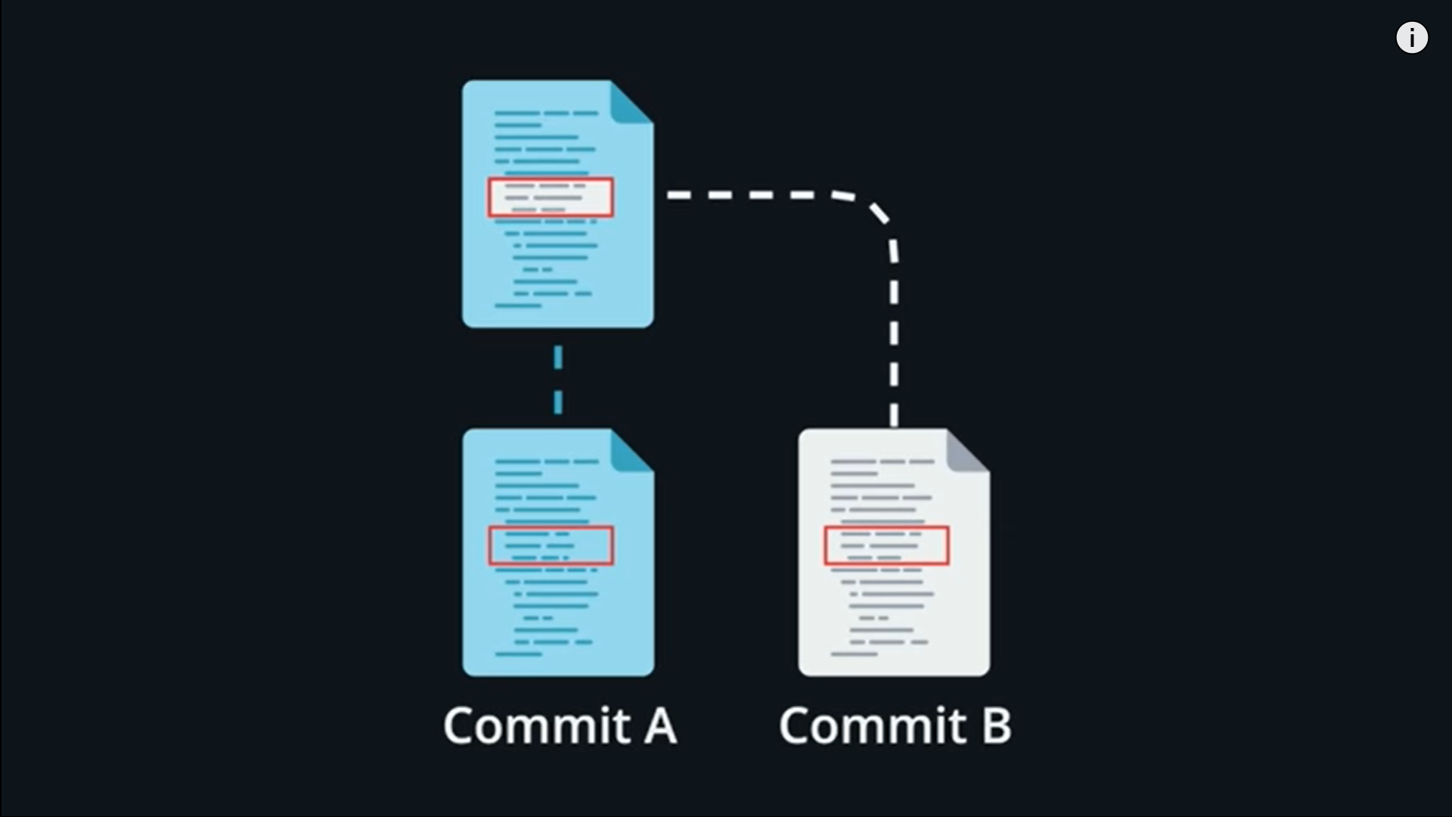
Resolving Merge Conflict
If git encounter with conflict it will highlight the conflicted area and ask user which code to keep or delete once user decide then git automatically merge two conflict and resolve merge conflict

Slide 39
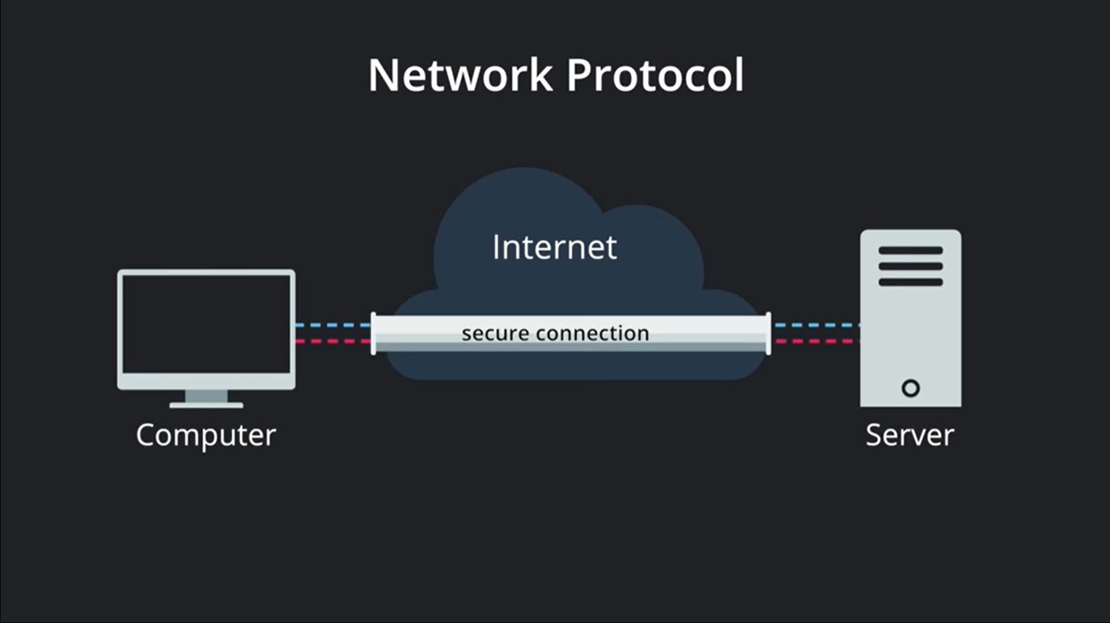
3. SSH Authentication
SSH is a network protocol
Responsible for providing secure connection b/w client –server model
By using SSH Authentication we can remotely access the Github from our local computer

Slide 40
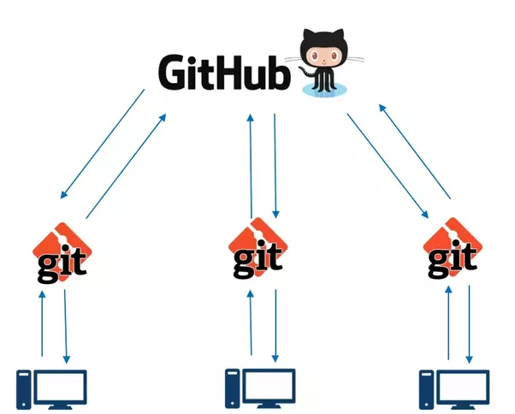
Connecting to Github by SSH
Steps for establishing connection b/w git and github by SSH :-
Step 1:- Generate SSH Key
Step 2:- Upload Public Key to Github
Step 3:- Deploy SSH agent
Step 4:- Connection Established

Slide 41
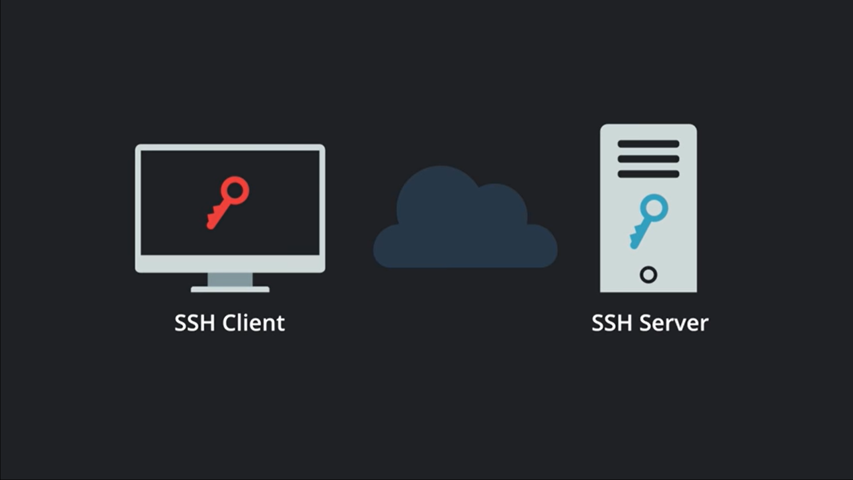
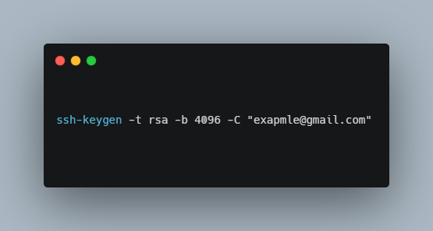
Step 1:- Generating SSH Key
SSH can be setup by using a pair of keys i.e
Private Key (stored on SSH client)
Public Key (stored on the server)
SYNTAX FOR GENERATING SSH KEY :-
Public Key
Private key

Slide 42
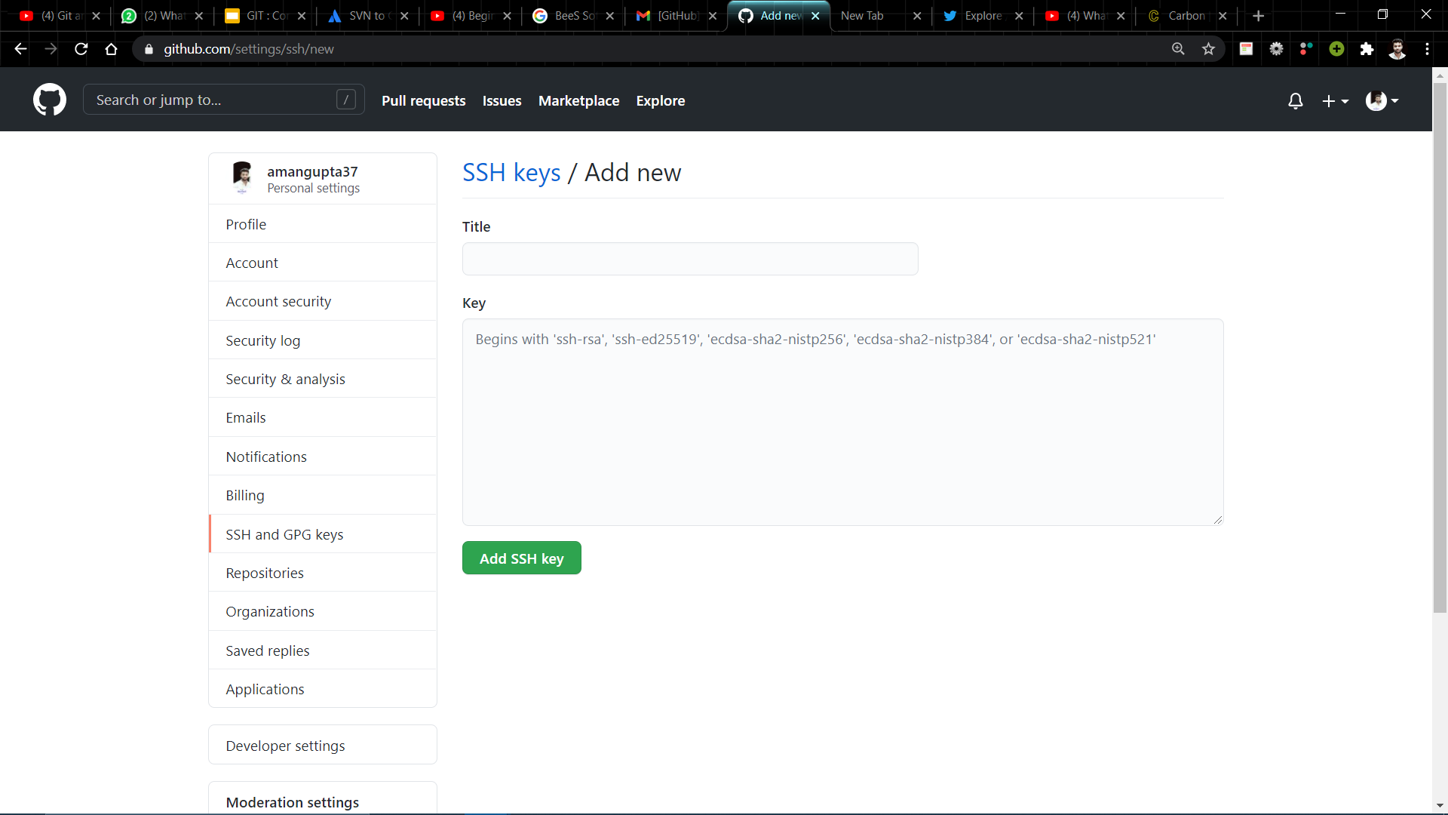
Step 2:- Uploading Public Key to Github

Slide 43

Step 3:- Deploying SSH Agent
The ssh-agent is a helper program that keeps track of user's identity keys and their passphrases.
The agent can then use the keys to log into other servers without having the user type in a password or passphrase again.
This implements a form of single sign-on (SSO).

Slide 44

4. Pushing Code to the Github
Steps for pushing code to the github
Step 1 : Create a Repository on github
Step 2: Copy the Repository link from github and execute below command
(This command is used to connect your local repository to the remote server.)

Slide 45

Step 3 : Now to push code into github repository use the below command
Step 4 : The code is now successfully pushed to github . Referesh the github page to see the final result.
(This command sends the committed changes of master branch to your remote repository.)

Slide 46




THANK YOU !
Connect with me on
Connect with devkode.io

